Slide 1
Industry use-cases
EuroCC-1 & -2 portfolio

Slide 2
Content
NCC Name | Number of use cases reported
Austria | 2
Belgium | 4
Bulgaria | 2
Croatia | 3
Czechia | 13
Estonia | 4
France | 6
Hungary | 2
Latvia | 2
Slovakia | 2
Sweden | 3
Türkiye | 6
TOTAL | 49

Slide 3
Austria

Slide 4

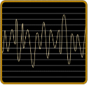
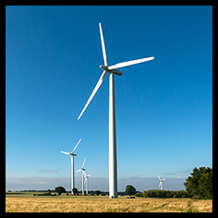
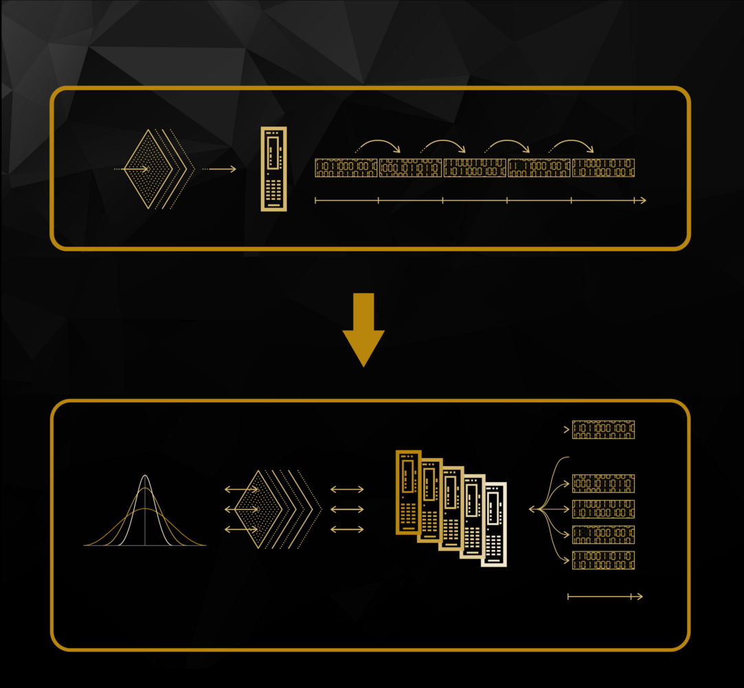


Time Series in the Energy Sector
Energy
Company
HAKOM is the technology leader for time series management in the energy industry. Its PowerTSM® Technology enables and accelerates innovation.
Challenges & Solution
The energy sector generates more data than ever before - most of it is time series data. In order to add more advanced big data analytics capabilities, the company tested its technology on a supercomputer. EuroCC Austria referred HAKOM to the experts of the Little Big Data (LBD) cluster, an HPC system at TU Wien. The successful integration of time series management (TSM) software on a highly parallel cluster enables HAKOM now to further develop the tools for analysis of very large data sets directly through its TSM system.
Benefits
⫸ more advanced big data analytics capabilities available
⫸ enables development of tools for analysis of very large data sets directly through its TSM system
Full story:
“With the guidance of the EuroCC team we decided to export our time series data to parquet files ... With all the data residing in the distributed network file system reading subsets of data – roughly 10 GB – into a Spark distributed data frame became both doable and reasonably fast.”
Gregor Beyerle, Data Scientist @HAKOM
⫸ whole story
Simeon Harrison, EuroCC Austria, info@eurocc-austria.at

Slide 5
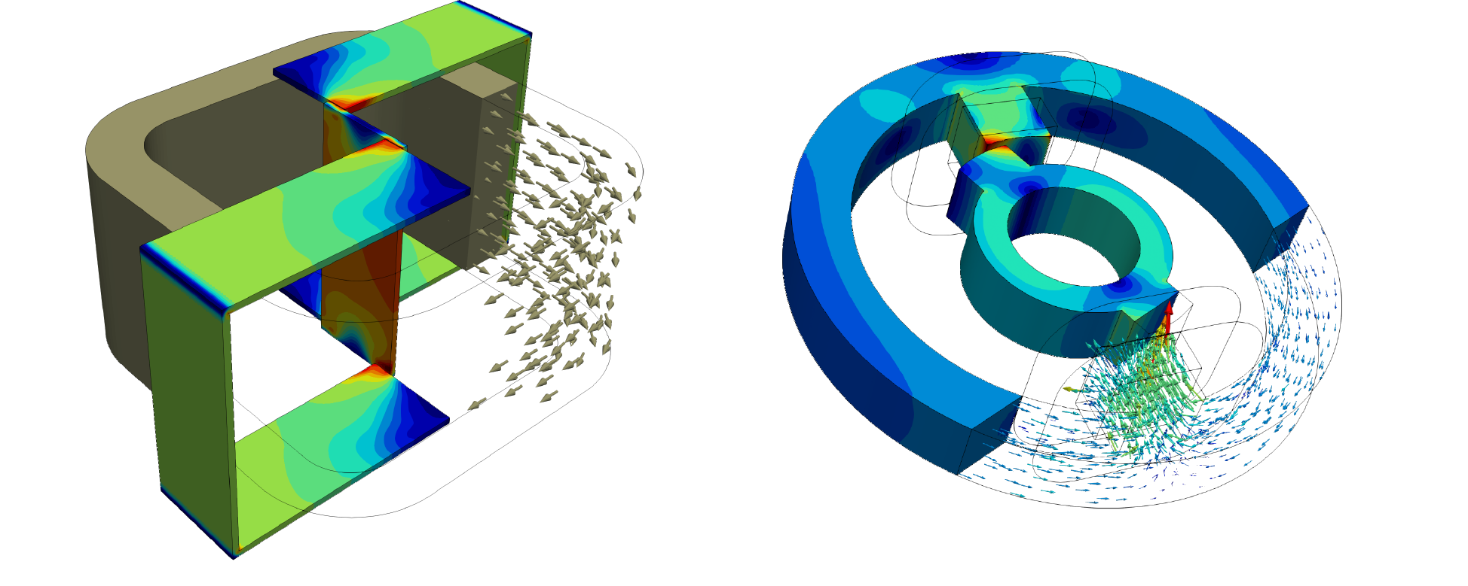
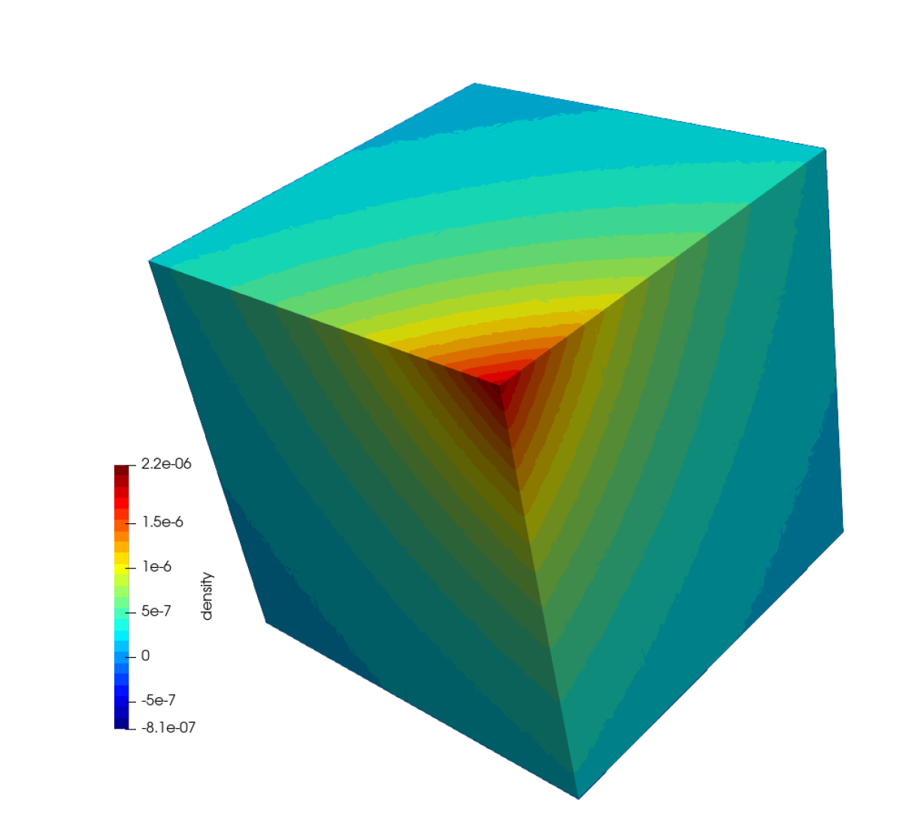

Electromagnetic Simulations
Electrical and electronic engineering
Company
TAILSIT, a company from Graz, Austria produces custom-fit simulation software tools for computational electromagnetics and structural analysis.
Challenges & Solution
TAILSIT's distinctive software library employs a coupled Finite/Boundary Element Method (FEM/BEM) for electromagnetic analysis. BEM, with quadratic complexity, becomes nearly linear through Fast Multipole Method (FMM) integration. Challenges arose in limited desktop capacity. With support from the Vienna Scientific Cluster (VSC) at TU Wien the software was adapted for HPC machines, yielding significant runtime enhancements and the ability to handle problems with up to 50·10⁹ degrees of freedom, a major leap from its previous capacity of 10⁶.
Benefits
⫸ significant run-time improvements
⫸ good overall scaling for up to a few thousand CPUs
⫸ achievement of significant upscaling of degrees of freedom
Unit cube and its calculated potential caused by a given fundamental solution
Full story:
“Based on the results and the knowledge acquired from this project, we were able to further develop our method such that the first industrial applications have been simulated. In order to harden the algorithms and thus to achieve a sustainable implementation, we will again seek cooperation with the VSC team.”
Dr. Jürgen Zechner, CEO @TailSiT
⫸ publication
Dr. Soner Steiner, EuroCC Austria, info@eurocc-austria.at

Slide 6
Belgium

Slide 7
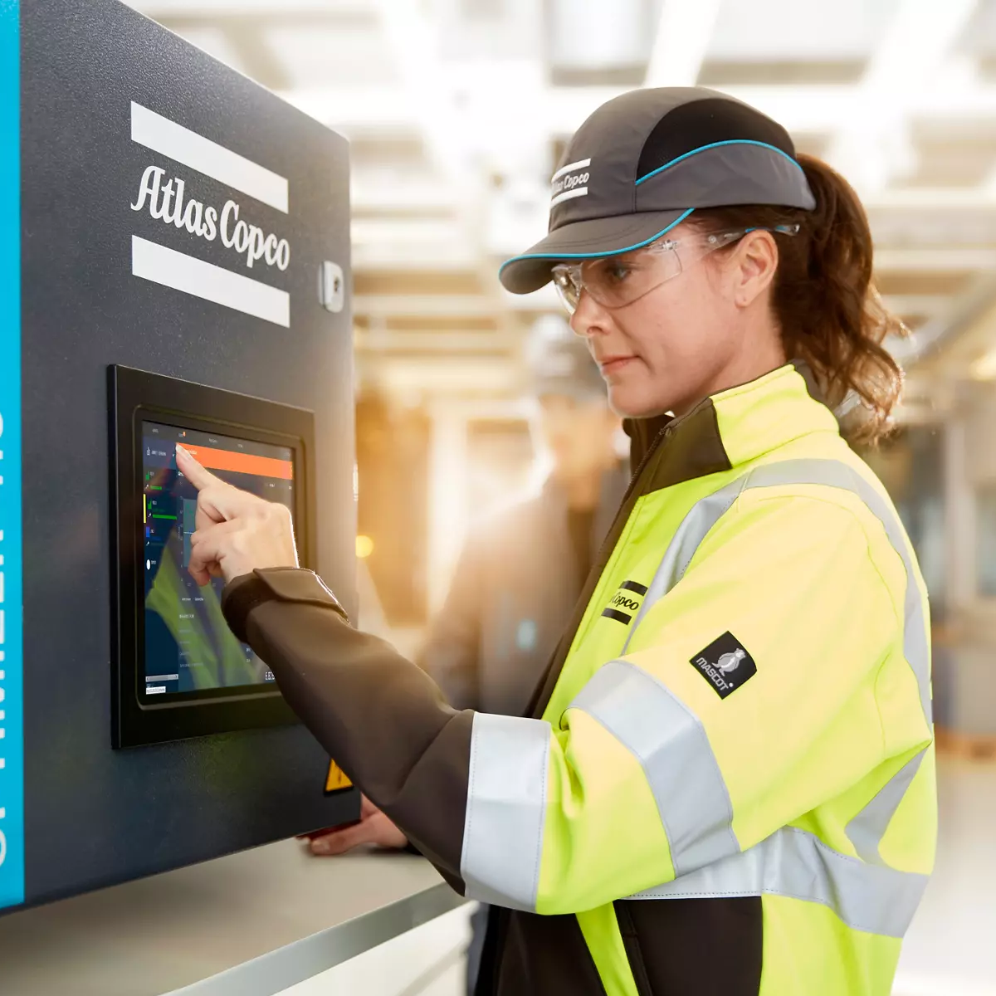

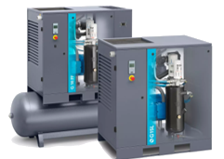
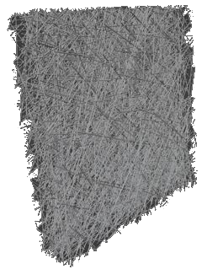
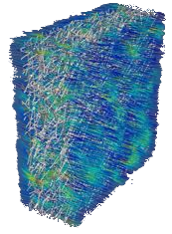


Understanding physics at the microscale in filter media
Manufacturing & Engineering
Company
Atlas Copco is specialized in the design, development and manufacturing of industrial compressors and expanders, vacuum solutions and air and gas treatment equipment.
Challenges & Solution
The flow geometry and physics at the microscale in filter media are complex and require state-of-the-art computational fluid dynamics techniques to resolve. The required computational resources are extensive and need world-class high-performance computing.
Simulations were first performed to build the necessary experience in efficiently running large-scale calculations and exploring the computational limits. Using VSC infrastructure gave Atlas Copco access to new simulation techniques to investigate the microscale behavior of oil aerosol filter media.
Benefits
 Accelerate the development of new and better designs
 Simulation of more physics and larger problems that were infeasible before
☞ Cleaner air delivered at a lower energy cost to our customers
Virtual filter medium microstructure
Streamlines flow through a filter medium coloured by velocity magnitude
Full story:
“Atlas Copco wanted to have a better understanding of microscale air and oil flow behaviour in oil aerosol filter media. If we better understand the physics at this scale, we can design filters with higher filtration efficiency at a lower pressure drop. This, in the end, results in cleaner air delivered at a lower energy cost to our customers” Tom Saenen, Technology developer @Atlas Copco
Carl MENSCH, Industry EuroCC BE, carl.mensch@uantwerpen.be

Slide 8

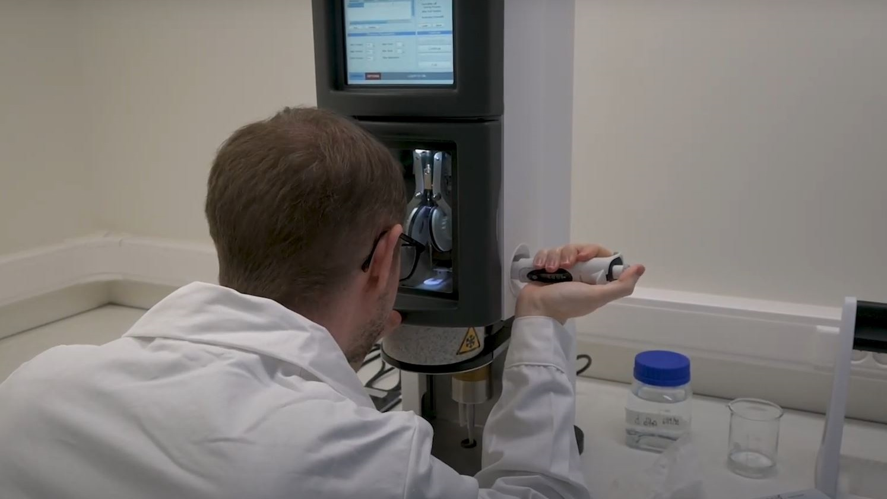

Matchmaking, mapping industry challenges to research
Biotechnology / Bioinformatics
Company
PUXANO is a biotech company offering structure-based protein research services to pharma and biotech companies. The company differentiates from others by developing its own technologies to accelerate the process of obtaining protein structures.
Challenges & Solution
The procondor platform helps to optimize the protein sequence in a semi-automated manner. Puxano initially used the platform internally but wanted to automate it further and make it available for others to use.
To meet this computational demand, Puxano has employed the HPC services of VSC. Furthermore, VSC introduced Puxano to the Data Science Institute of UHasselt (DSI). DSI helped Puxano design a suitable database structure. The developed database is being incorporated into the Puxano analysis pipelines and serves as the core source of information for the Puxano (web-based) service platform.
Benefits
VSC as match-maker between Puxano and DSI
DSI gave new insights to design a suitable database structure
☞ The developed database serves as the core source of information for the Puxano (web-based) service platform.
Full story:
“Our key objective was to rethink our script for protein construct design into a software platform. The idea was to find out which type of database structure served best to integrate protein information in different formats, have efficient data storage, easily updatable and searchable. Our collaboration with academia was very valuable for the success of the project” Wouter Van Putte, Director & co-Founder @Puxano
Carl MENSCH, Industry EuroCC BE, carl.mensch@uantwerpen.be

Slide 9


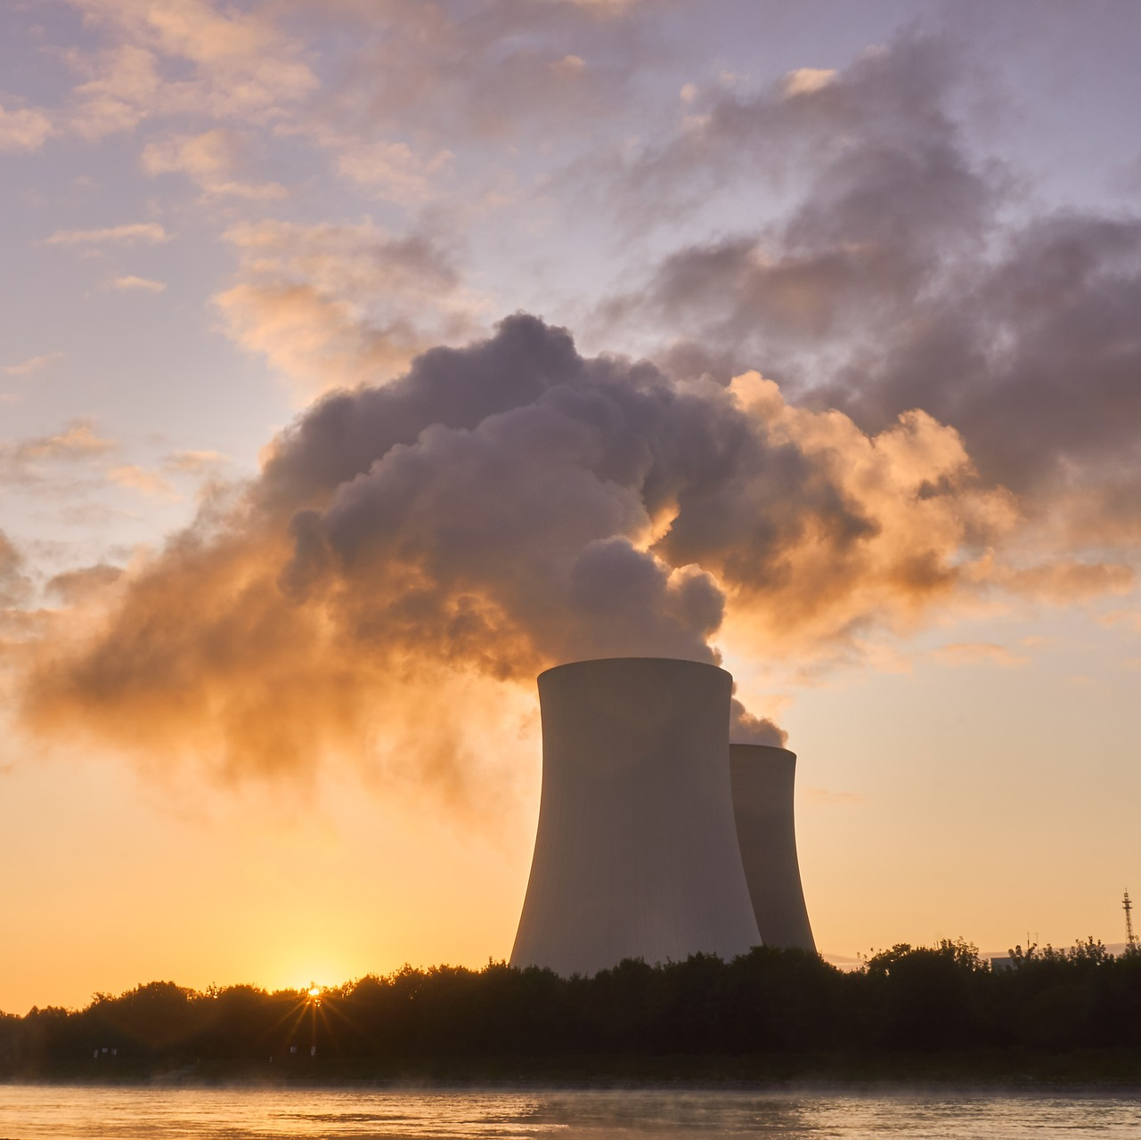

The Role of HPC in Ensuring Nuclear Reactor Safety
Energy
Company
Founded in Belgium 150 years ago, Tractebel is today one of the world's leading engineering companies for energy, water and infrastructure projects.
Challenges & Solution
In 2012, the federal agency of nuclear control of Belgium reported defects in the vessels of the nuclear reactor Doel 3 and Tihange 2. Among a lot of analyses, numerical simulation has been chosen to assess the risk level.
These simulations were highly computationally demanding. A single computation required a high quantity of memory (up to 128Gb for the first computations – feasibility proved up to 768Gb). Due to the high number of configurations to compute (some hundreds), combined with the memory needs, the use of HPC infrastructure was a requirement.
Benefits
HPC helped in the assessment of structural integrity
Safe restart of the reactors (combined with inspections)
☞ Tractebel acquired unique expertise and now conducts its own analyses on various parts of nuclear power plants internally but also for its partners.
Full story:
“Multiple crack configurations required much caution to perform the computation within the available hardware resources while satisfying high-quality standards in the results. Cenaero developed methodologies to face the challenges (number of configurations, memory and restitution time limitations, post-processing). ” Valéry Lacroix, Technical manager of seism & structural integrity group @Tractebel
Frédérique Jacobs, Industry EuroCC BE, frederique.jacobs@cenaero.be

Slide 10

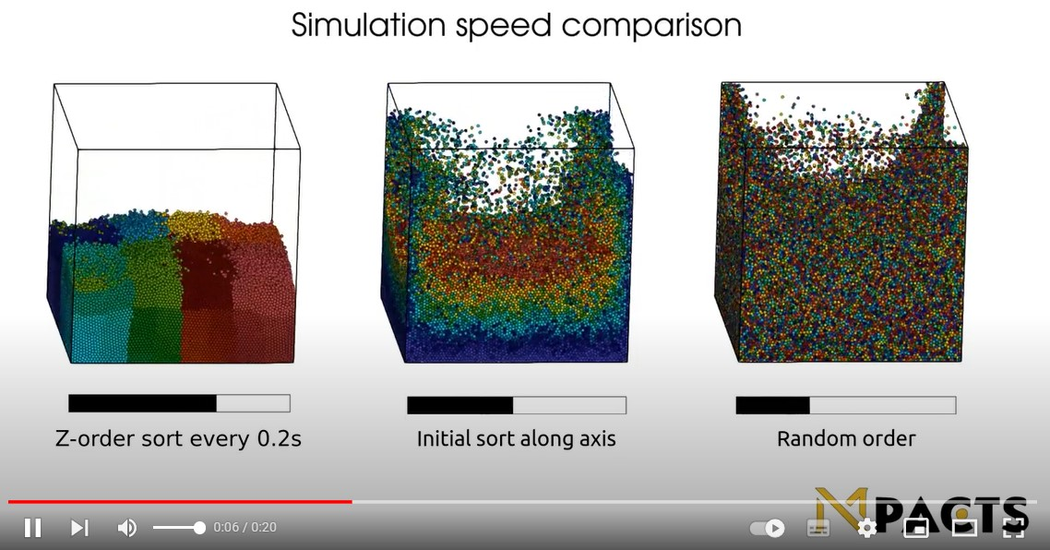

Leveraging expertise
IT/HPC systems, services & software
Company
Founded in 2018, Mpacts is a SME dedicated to te development of Mpacts simulation software. It is designed to simulate the behaviour of granular materials, assemblies of large numbers of particles in industrial processes.
Challenges & Solution
While granular dynamics is conceptually very similar to molecular dynamics, it is also much more complex since particles have shape and complex interactions, which complicates contact detection. Develop computationally efficient simulation software for granular processes is critical.
The Flemish Supercomputing Center (VSC) recommended sorting the particles so that particles close in (simulated) space are also close together in computer memory. VSC also built a tool that automates the compilation of Python modules from C++/C/Fortran. These programming techniques made the software more efficient and, thus, faster.
Benefits
Sorting the particles in memory translates into faster computation times by factor 2 with existing hardware.
Performance increases by a factor of five with GPUs
☞ This improvement has a high impact on the responsiveness in solving engineering problems.
Full story:
“The ability to work with the highly skilled experts in the field of HPC at VSC was a very interesting and rewarding experience. I would recommend anyone involved in supercomputing to contact the VSC and benefit from their available expertise to improve your calculations.” Simon Vanmaercke, Co-Founder @Mpacts
Carl MENSCH, Industry EuroCC BE, carl.mensch@uantwerpen.be

Slide 11
Bulgaria

Slide 12
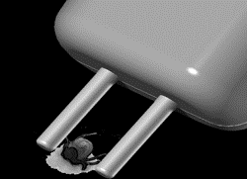


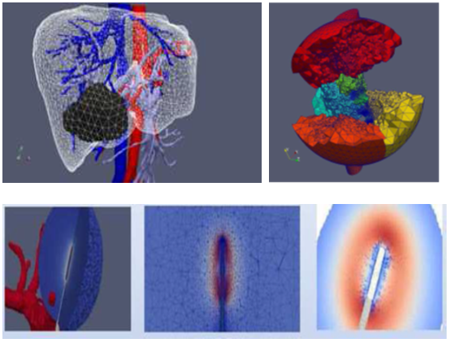


Supercomputer application in biomedical engineering
Health care / Pharmaceuticals / Medical devices
Company
AMET Ltd. is a company dedicated to development, modern manufacturing and distribution of electronic medical equipment and modules. It is a reliable and desired partner in Bulgarian and foreign market.
Challenges & Solution
The processes are substantially three-dimensional and time-dependent. The developed software tools for supercomputer simulation of coupled physical processes of radiofrequency electro surgery manipulations are beyond the scope of available commercial packages. Measurable indicators are applied to assess the reliability of the obtained results, thus providing proven criteria for minimizing subjective inaccuracies. The impact of using large-scale HPC models reached more than two times improved precision of evaluating the volume of effectively ablated tissue.
Benefits
Fully realistic computer simulation of strongly coupled processes of radiofrequency electrosurgical technologies.
Time/cost saving of parameter optimization of high tech low-invasive procedures.
Assessment and optimization of hard to measure complex processes.
Full story:
“The use of state-of-the-art modeling, simulation and high performance technologies is very important to our company. The business impact from our collaboration with IICT-BAS includes improving the technology characteristics of existing products and development of new products.”
Janet Popova, Managing DIrector @Amet Ltd.
Contact person at the NCC Bulgaria: Stanislav Harizanov, sharizanov@parallel.bas.bg
Notes:
Based on a success story in EuroCC 1
*Aeronautics, Agriculture, Automotive, Biotechnology/Bioinformatics, Chemicals, Cosmetics, Construction, Defence sector, Earth science, Electrical and electronic engineering, Energy, Environment/climate/weather, Food and drink, Finance/Insurance, Health care / Pharmaceuticals / Medical devices, IoT (Internet of things), IT/HPC systems, services & software providers, Life sciences, Manufacturing & engineering, Maritime, Material sciences, Mechanical engineering, Public services/Civil protection, Raw materials, metals, minerals and forest-based, Space, Smart City, Textile, Fashion and creative

Slide 13
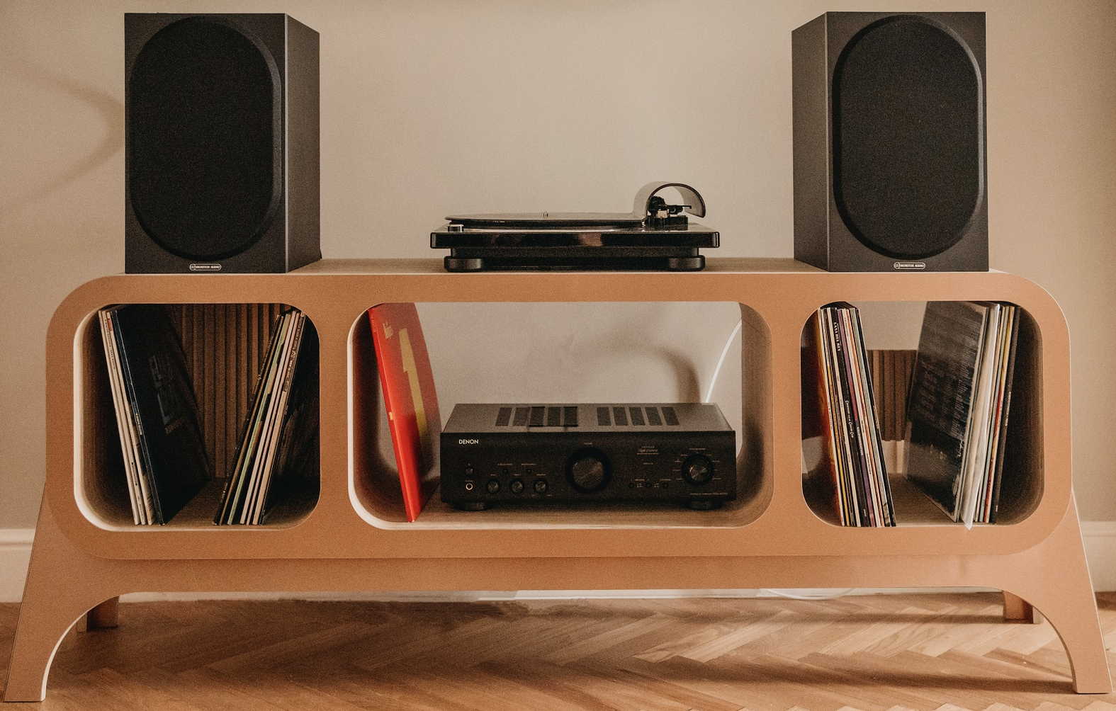

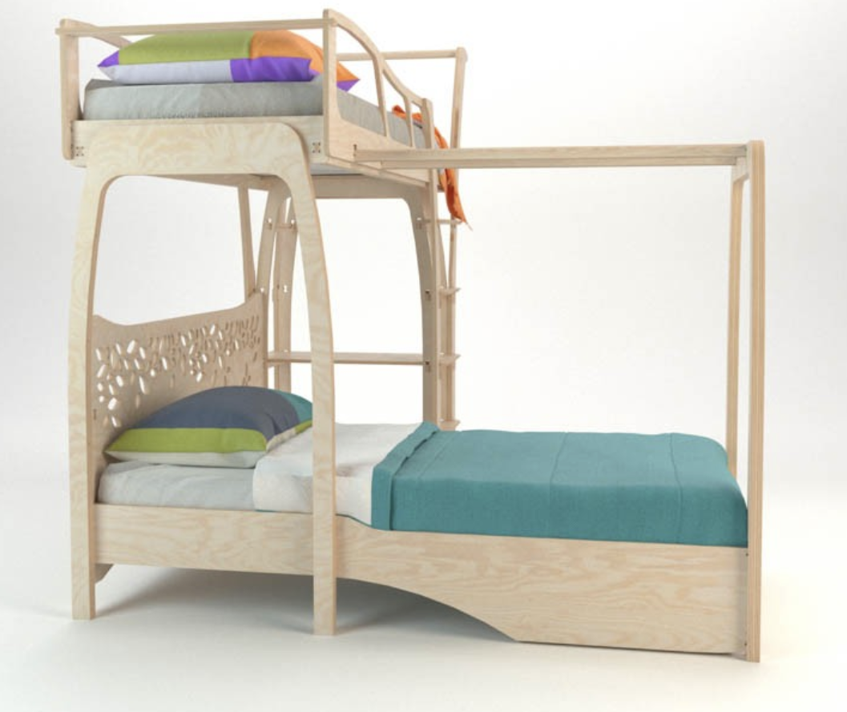

Improving the furniture precision
Manufacturing & Engineering
Company
PLYGear is specialized in the design, computer modelling and manufacturing of furniture born in timely recorded digital dreams supported by the plywood unique properties.
Challenges & Solution
The models designed and implemented in virtual environment are complex and require state-of-the-art computational techniques to resolve. The required computational resources are extensive and need high-performance computing as all Plygear items need the precision of the modern processing methods.
Simulations were performed to acquire knowledge in running effectively new design methods. The impact of using large-scale HPC models improved both the precision and the production rate.
Benefits
✓ Accelerate the development of new designs via simulations
✓ Each model is designed and implemented in virtual environment
☞ a functional minimalist design offered to our customers
Full story:
“PLYGear wanted to have a better approach to furniture design for a complex environment by mixing ideas with passion and engineering precision. The most characteristic of all PLYGear items is that thanks to the precision of the modern processing methods the assemblies are made extremely reliable and impeccable. ” Borislav Georgiev, MS in Engineering, Technology Developer @PLYGear
Contact person at the NCC BG: Ana Proykova, anap@phys.uni-sofia.bg
Notes:
*Aeronautics, Agriculture, Automotive, Biotechnology/Bioinformatics, Chemicals, Cosmetics, Construction, Defence sector, Earth science, Electrical and electronic engineering, Energy, Environment/climate/weather, Food and drink, Finance/Insurance, Health care / Pharmaceuticals / Medical devices, IoT (Internet of things), IT/HPC systems, services & software providers, Life sciences, Manufacturing & engineering, Maritime, Material sciences, Mechanical engineering, Public services/Civil protection, Raw materials, metals, minerals and forest-based, Space, Smart City, Textile, Fashion and creative

Slide 14
Croatia

Slide 15

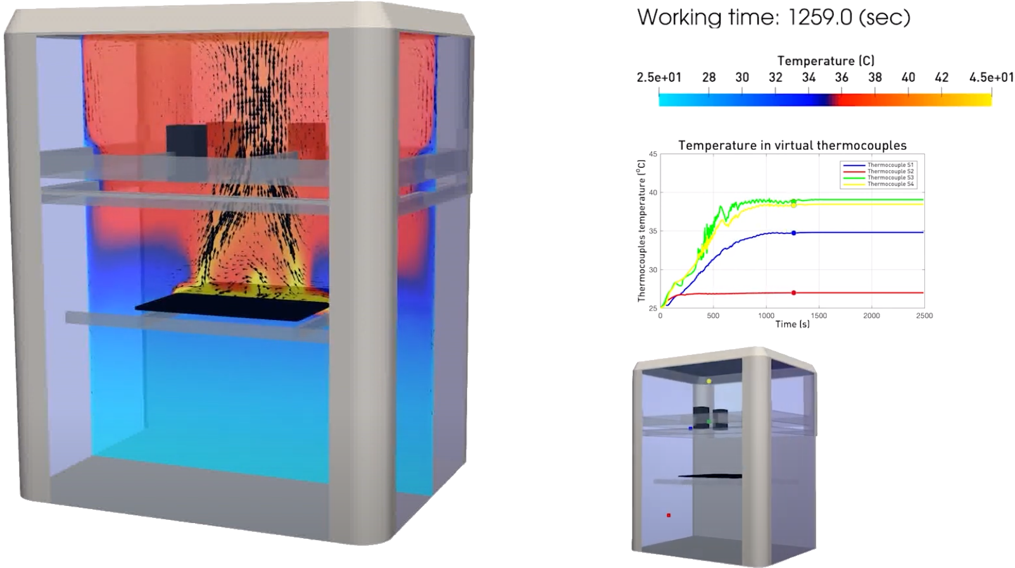
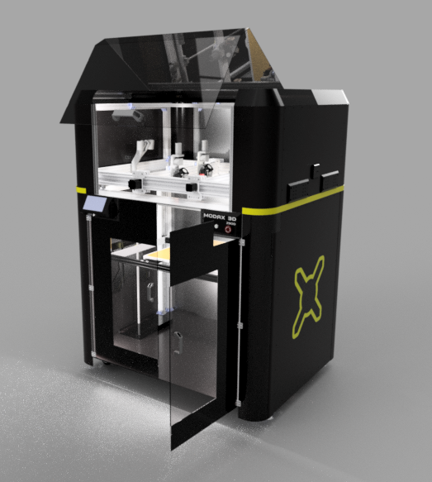
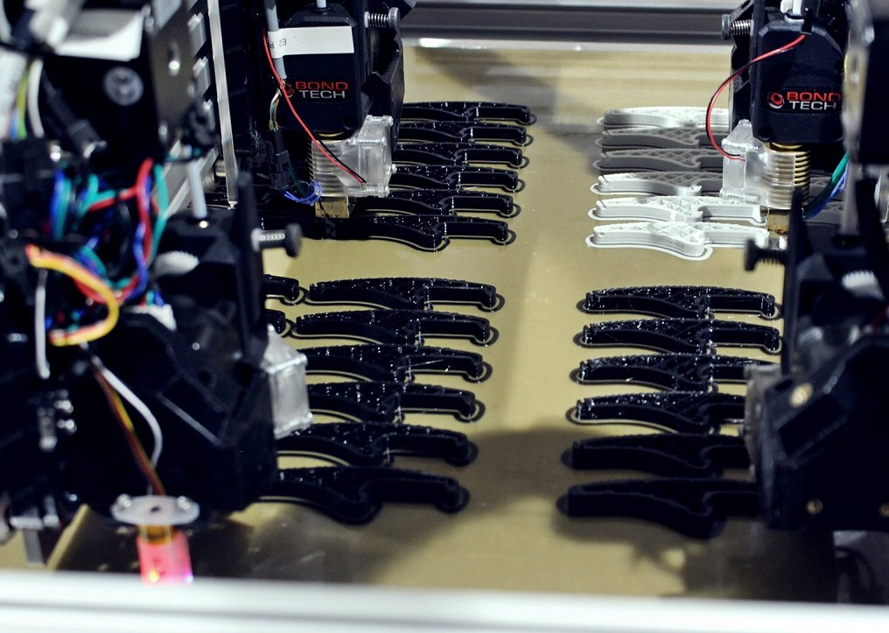


HPC-based Stabilization for Additive Manufacturing
Manufacturing & engineering
Company
Mikrotvornica d.o.o. specializes in high-quality prototype and product production using advanced technologies, with a strong focus on additive and digital manufacturing.
Challenges & Solution
The aim of the project is to reduce heat-induced deformations in 3D-printed objects. These deformations can significantly affect the quality and functionality of the final product. Based on computational fluid dynamics simulations performed using the HPC infrastructure, through an iterative processes and fine-tuning, an improved 3D printer assembly was created. In addition, the additive manufacturing process was improved by outlining and providing complete control over the parameters that affect the dimensional stability of 3D printed products.
CFD-based tuning process.
Modified 3D printer and object printing.
Benefits
Shorter delivery times by up to 50%.
Reduction of up to 30% in production costs.
Savings of €150.000,00 over a period of three years.
Increase in sales by up to 30%.
Full story:
“In cooperation with the members of NCC Croatia (RBI), we were provided with professional support and extensive experience with regards to the application of high-performance computing in order to improve 3D printing characteristics and capacities.”
Nikola Blažević, CEO @Mikrotvornica
Lado Kranjčević, NCC Croatia, lado.kranjcevic@riteh.hr
Notes:
*Aeronautics, Agriculture, Automotive, Biotechnology/Bioinformatics, Chemicals, Cosmetics, Construction, Defence sector, Earth science, Electrical and electronic engineering, Energy, Environment/climate/weather, Food and drink, Finance/Insurance, Health care / Pharmaceuticals / Medical devices, IoT (Internet of things), IT/HPC systems, services & software providers, Life sciences, Manufacturing & engineering, Maritime, Material sciences, Mechanical engineering, Public services/Civil protection, Raw materials, metals, minerals and forest-based, Space, Smart City, Textile, Fashion and creative

Slide 16

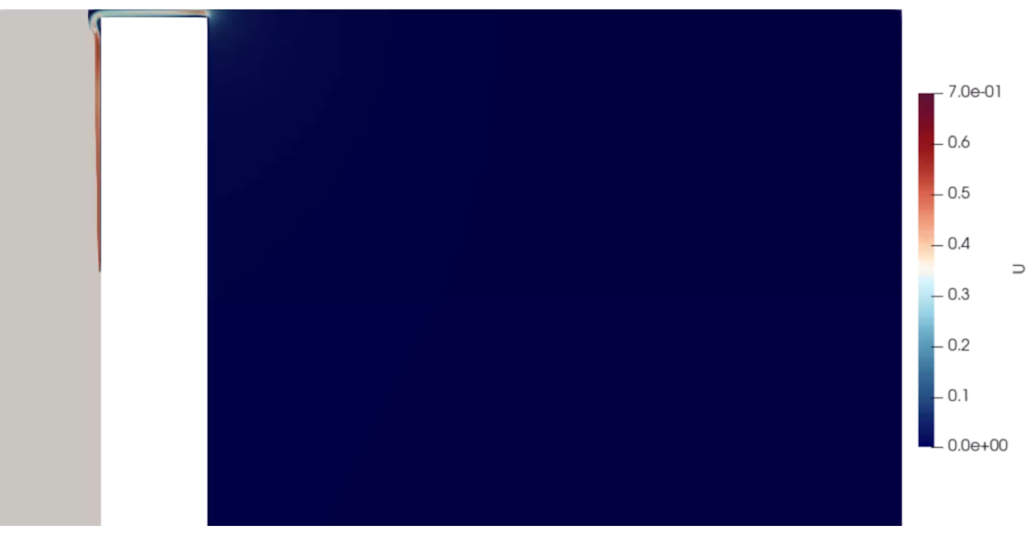
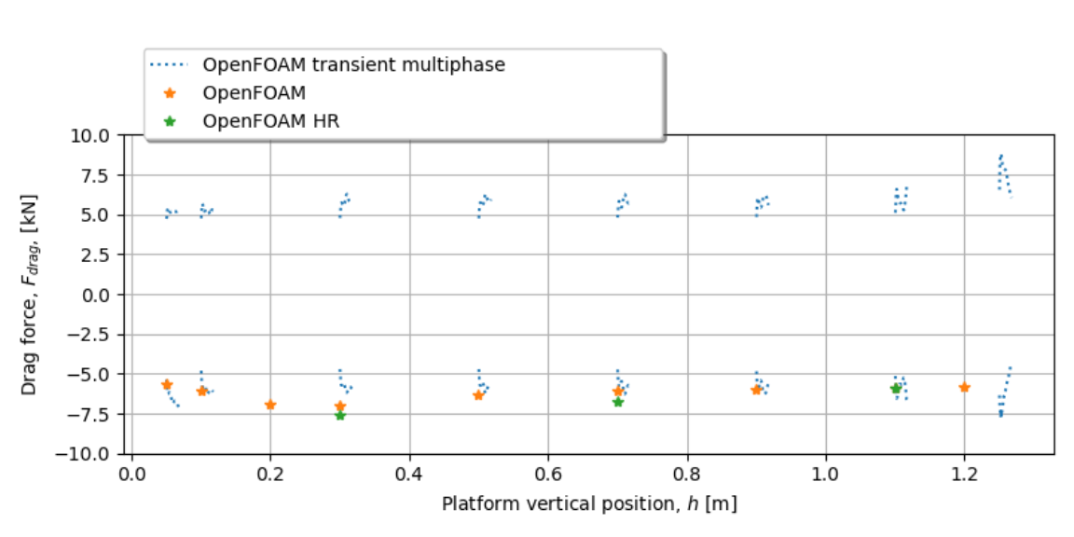
Dynamic Fluid-Object Interactions During Motion
Mechanical engineering
Company
AITAC d.o.o. is a local subsidiary providing yacht, naval, cruise ship, marine & offshore engineering and PLM services in shipbuilding and offshore industry.
Challenges & Solution
Simulating the movement of submerged objects in a fluid-filled tank can be a challenging task. The dynamic interaction introduces a variety of problems e.g. sloshing and potential spillage, all of which must be accurately characterized and effectively mitigated. The use of high performance computing is indispensable for the successful execution of these computational fluid dynamics simulations.
A carefully crafted plan for the optimal motion of objects is proposed. This plan represents a delicate equilibrium between the minimization of waiting times and the prevention of water spillage, and as such improves the overall system performance.
Simplified / representative problem concept.
Forces at relevant locations.
Benefits
Optimized system performance by minimizing waiting times
Facilitated the rapid exploration of novel design possibilities
Optimal movement plan contributes to safer and more reliable system
Full story:
“We were interested in the displacement of the water during the movement and were unsure of the bottom's impact on the flow and the force due to the negative pressure. Given that this is a component of a larger system, we needed a solution that would ensure uninterrupted and optimal operation.”
Domagoj Borucinsky, Engineer @AITAC
Lado Kranjčević, NCC Croatia, lado.kranjcevic@riteh.hr
Notes:
*Aeronautics, Agriculture, Automotive, Biotechnology/Bioinformatics, Chemicals, Cosmetics, Construction, Defence sector, Earth science, Electrical and electronic engineering, Energy, Environment/climate/weather, Food and drink, Finance/Insurance, Health care / Pharmaceuticals / Medical devices, IoT (Internet of things), IT/HPC systems, services & software providers, Life sciences, Manufacturing & engineering, Maritime, Material sciences, Mechanical engineering, Public services/Civil protection, Raw materials, metals, minerals and forest-based, Space, Smart City, Textile, Fashion and creative

Slide 17

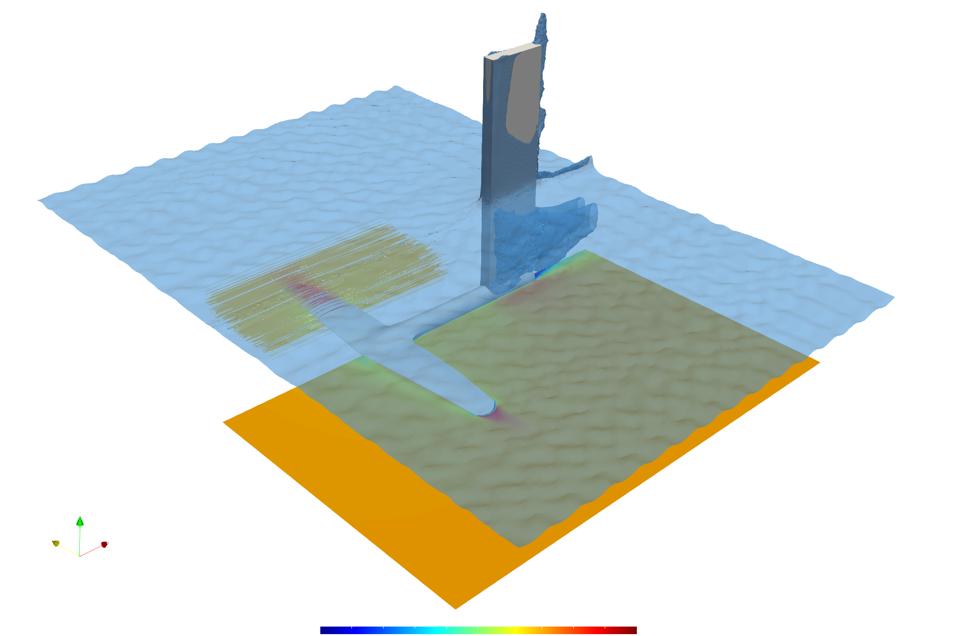
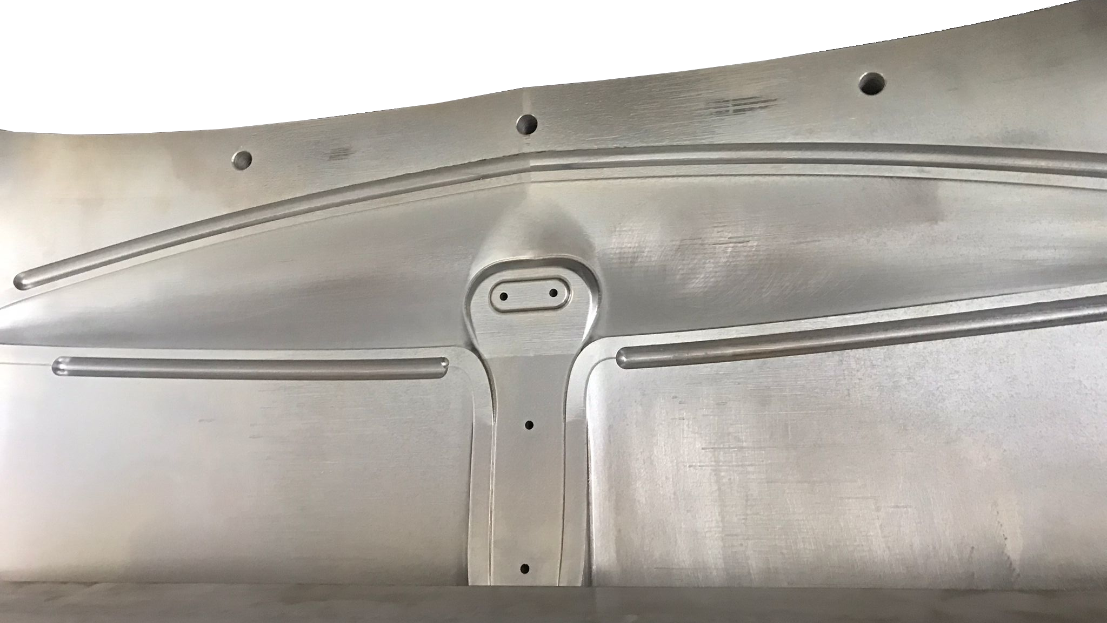
Digital Twin Framework for Hydrofoil Optimization
Manufacturing & engineering
Company
Marotti Windsurfing d.o.o. is a company founded by the two-time windsurfing champion. MWSC is dedicated to the development and production of windsurfing equipment.
Challenges & Solution
In close cooperation with IIT d.o.o., specialized equipment and software were developed to ensure precise measurements of fluid data. A methodology based on reverse engineering and digital twin technology was developed to design an optimized hydrofoil. The mold creation process saw collaboration with members from the Academia and Bex d.o.o., resulting in a robust approach to aluminium mould production. State-of-the-art techniques were employed to produce and thoroughly test new hydrofoil prototypes.
CFD-based design optimisation
Hydrofoil mold used to create a prototype design.
Benefits
Enhanced hydrofoil windsurfing performance.
Competitive and industrial advantage (improved products).
Industry/company growth.
International recognition.
Futureproofing.
Full story:
“I am grateful for the accessibility, willingness, and enthusiasm in order to jointly achieve success. Our goal is to create a so-called 'speed foil' hydrofoil with which we will attempt to break the speed world record. I am confident, based on current results, that we will achieve this.”
Enrico Marotti, CEO @Marotti Windsurfing
Lado Kranjčević, NCC Croatia, lado.kranjcevic@riteh.hr
Notes:
*Aeronautics, Agriculture, Automotive, Biotechnology/Bioinformatics, Chemicals, Cosmetics, Construction, Defence sector, Earth science, Electrical and electronic engineering, Energy, Environment/climate/weather, Food and drink, Finance/Insurance, Health care / Pharmaceuticals / Medical devices, IoT (Internet of things), IT/HPC systems, services & software providers, Life sciences, Manufacturing & engineering, Maritime, Material sciences, Mechanical engineering, Public services/Civil protection, Raw materials, metals, minerals and forest-based, Space, Smart City, Textile, Fashion and creative

Slide 18
Czechia

Slide 19

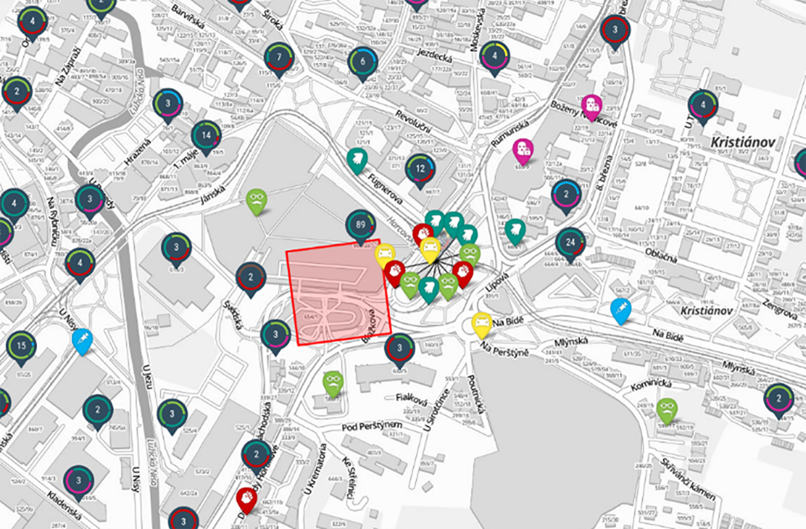


Tool to fight criminality more effectively
Security
Company
The Police of the Czech Republic are an armed security force established by the National Council Act of 21 June 1991. The Police of the Czech Republic serves the public.
Challenges & Solution
The practical part of the Maps of the Future II project aimed to use crime data to develop and test new procedures and tools for more effective crime fighting and more targeted, efficient, and thus cheaper use of resources (personnel, financial, and material).
Models designed to predict crime and socio-pathogenic phenomena throughout the Czech Republic were successfully developer and tested. The possibility of running memory and computationally demanding tasks in parallel using dedicated graphics cards proved crucial, allowing individual experiments to be reduced from days to hours.
Benefits
The criminality prediction model training time was reduced several fold
The training done on the GPU nodes of the Karolina cluster was shown to be effective
The solution will help the Police of the Czech Republic increase the efficiency of their patrol planning.
Photo provided by the Police of the Czech Republic.
Full story:
“I am very pleased that the employees of the Police of the Czech Republic are actively involved in the search for innovations and solutions to one of the current topics in the internal security of the Czech Republic, which is the effective use of available resources (both human and material).“ genmjr. Martin Vondrasek, Police President
Contact person at the NCC: Tomas Karasek, tomas.karasek@vsb.cz
Notes:
*Aeronautics, Agriculture, Automotive, Biotechnology/Bioinformatics, Chemicals, Cosmetics, Construction, Defence sector, Earth science, Electrical and electronic engineering, Energy, Environment/climate/weather, Food and drink, Finance/Insurance, Health care / Pharmaceuticals / Medical devices, IoT (Internet of things), IT/HPC systems, services & software providers, Life sciences, Manufacturing & engineering, Maritime, Material sciences, Mechanical engineering, Public services/Civil protection, Raw materials, metals, minerals and forest-based, Space, Smart City, Textile, Fashion and creative

Slide 20

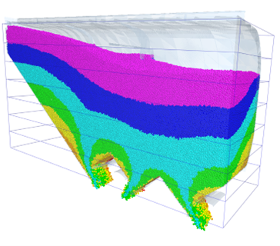

Use of Bulk Simulation in the Development of a Rail Freight Wagon
Manufacturing & Engineering
Company
Advanced Engineering is a company that focuses on computer simulations, structural analysis and optimisation of structures, and multi-physics modelling and simulation.
Challenges & Solution
End customers and users asked for a guarantee for the time required to unload each wagon during unloading, and the development team needed to make sure that the geometry of the hoppers and funnels would ensure the complete discharge of bulk material without it being stuck to the walls.
The solution can simulate the interaction of the bulk material with the structure, the ability to compare multiple design options, and the ease of analysing the behaviour of different grain types under various external conditions such as temperature and humidity.
Benefits
 Time and costs savings through numerical modelling and simulations
 The ability to simulate the interaction of the bulk material with the structure
 The ability to compare multiple design options
Ongoing simulation of emptying a freight wagon box – one-quarter simulation model.
Full story:
“The advantage of computer simulations of bulk material movement for this problem over physical testing is that the cost of hiring grain silos and grain costs are eliminated.“ Tomas Curda, Business Development Manager, Advanced Engineering, s.r.o.
Contact person at the NCC: Tomas Karasek, tomas.karasek@vsb.cz
Notes:
*Aeronautics, Agriculture, Automotive, Biotechnology/Bioinformatics, Chemicals, Cosmetics, Construction, Defence sector, Earth science, Electrical and electronic engineering, Energy, Environment/climate/weather, Food and drink, Finance/Insurance, Health care / Pharmaceuticals / Medical devices, IoT (Internet of things), IT/HPC systems, services & software providers, Life sciences, Manufacturing & engineering, Maritime, Material sciences, Mechanical engineering, Public services/Civil protection, Raw materials, metals, minerals and forest-based, Space, Smart City, Textile, Fashion and creative

Slide 21

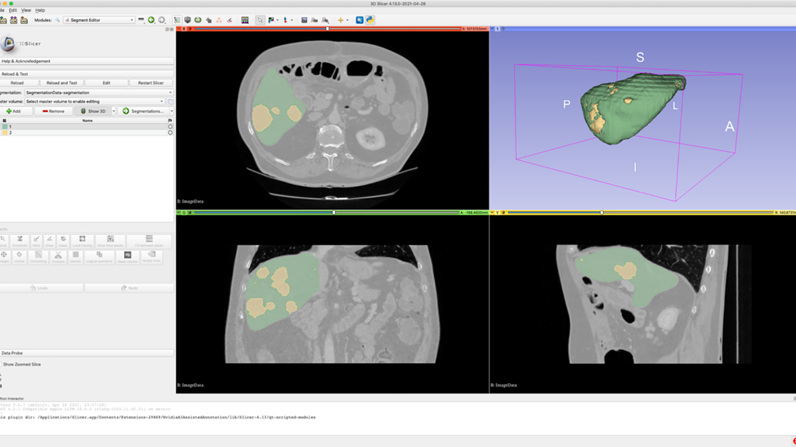

Medical Image Processing
Healthcare
Company
University Hospital Ostrava is a state-funded organisation established by the Ministry of Health of the Czech Republic. The primary purpose of this organisation is to provide health services.
Challenges & Solution
The main goal of the cooperation was to deploy and test a tool providing remote automatic tissue segmentation from patient image data obtained from computed tomography (CT) or magnetic resonance imaging (MRI) on supercomputers at IT4Innovations National Supercomputing Center.
The automated segmentation process can be applied to specific tissues of real interest to the physician, and the resulting model can be further used to plan healthcare tailored to the individual patient.
Benefits
The time of the segmentation process is reduced by automation
Spared time can be used for the physician´s benefit
The automated segmentation process can be applied to specific tissues of interest to the physician
3D Slicer working environment with possible output obtained by automatic segmentation on HPC cluster.
Full story:
“Using this toolkit is beneficial for both patients and physicians, as automation allows us to achieve high-quality image reconstructions in a fraction of the time and with minimal effort.“ Jan Roman, MD, University Hospital Ostrava
Contact person at the NCC: Tomas Karasek, tomas.karasek@vsb.cz
Notes:
*Aeronautics, Agriculture, Automotive, Biotechnology/Bioinformatics, Chemicals, Cosmetics, Construction, Defence sector, Earth science, Electrical and electronic engineering, Energy, Environment/climate/weather, Food and drink, Finance/Insurance, Health care / Pharmaceuticals / Medical devices, IoT (Internet of things), IT/HPC systems, services & software providers, Life sciences, Manufacturing & engineering, Maritime, Material sciences, Mechanical engineering, Public services/Civil protection, Raw materials, metals, minerals and forest-based, Space, Smart City, Textile, Fashion and creative

Slide 22

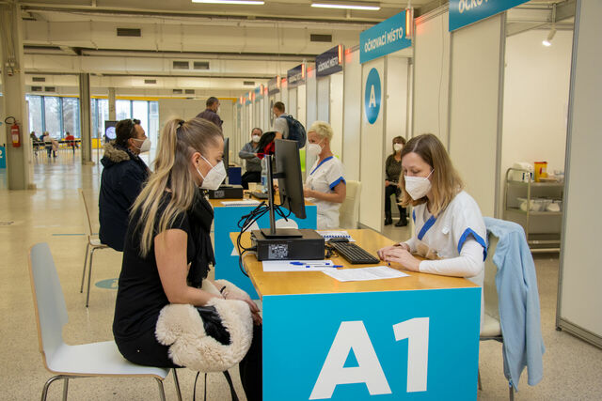

Launch of the Vaccination Centre
Healthcare
Company
This case has been handled together with the University Hospital Ostrava, Moravian-Silesian Region, Statutory City of Ostrava and Faculty of Medicine of the University of Ostrava.
Challenges & Solution
In March 2021, IT4T and the NCC in HPC collaborated on a joint project to build a large-scale vaccination centre in Ostrava, which was commissioned at the Černá louka site.
Our team created a simulation of the vaccination center's hall. This simulation detects critical vaccination centre points at times of high workload. Several bottlenecks in the original design, such as the waiting room after vaccination and the exit confirmation printing.
Benefits
The vaccination center can be designed efficiently in short period of time. Accurate detection of critical points and it´s redesign.
The required number of operator and staff positions for each station were identified.
The simulation also determines how many patients can be in the vaccination centre at any one time, at different stages.
A consultation before the vaccination process.
Full story:
”I appreciate the efforts of all the partners who have been and continue to be involved in constructing the vaccination centre. It is good to note that an important element in the design of such a centre was the supporting simulation, which was developed by scientists at IT4I and without which the testing of the capacity of the centre would have taken many times longer.“
Ivo Vondrak, Governor of the Moravian-Silesian Region
Tomas Karasek, tomas.karasek@vsb.cz
Notes:
*Aeronautics, Agriculture, Automotive, Biotechnology/Bioinformatics, Chemicals, Cosmetics, Construction, Defence sector, Earth science, Electrical and electronic engineering, Energy, Environment/climate/weather, Food and drink, Finance/Insurance, Health care / Pharmaceuticals / Medical devices, IoT (Internet of things), IT/HPC systems, services & software providers, Life sciences, Manufacturing & engineering, Maritime, Material sciences, Mechanical engineering, Public services/Civil protection, Raw materials, metals, minerals and forest-based, Space, Smart City, Textile, Fashion and creative

Slide 23
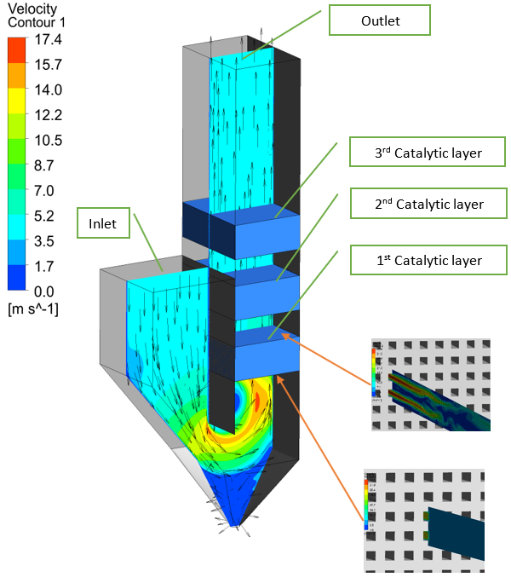

Computational Simulations for Emission Reduction in Combustion Plants
Energy
Company
The ORGREZ company provides services and supplies in several specific fields of power engineering, thermal engineering and ecology, generally in the processes of fuel energy conversion and electricity production and distribution.
Challenges & Solution
The main objective was to determine whether Computational Fluid Dynamics simulations could be used for the fast and efficient description of the selective catalytic reduction technology (SCR) catalysis process and, therefore, as a tool to mediate the design of a computational application for the design of this technology.
The use of numerical modelling and simulations will make the process more efficient, and faster and, most importantly, extend the application possibilities of this process, which will enable subsequent optimization of the designed solution and, thanks to high-performance computing, it will be possible to complete these simulations in a relatively short time.
Benefits
Confirmation of the applicability of CFD for SCR design and optimization
Time and costs saving due to speed up of SCR design process
Environmental impact due to optimised SCR design leading to increase of NOx emission reduction
CFD simulation of SCR process.
Full story:
“By speeding up the design process of the SCR technology, time and cost savings are achieved and, in addition, the optimised SCR technology design leads to more effective NOX emission reduction and extended technology lifetime, which has a positive impact on the environment.“
Vojtech Vavricka, Managing Director of the ORGREZ Division for Ecology Systems
Contact person at the NCC: Tomas Karasek, tomas.karasek@vsb.cz
Notes:
*Aeronautics, Agriculture, Automotive, Biotechnology/Bioinformatics, Chemicals, Cosmetics, Construction, Defence sector, Earth science, Electrical and electronic engineering, Energy, Environment/climate/weather, Food and drink, Finance/Insurance, Health care / Pharmaceuticals / Medical devices, IoT (Internet of things), IT/HPC systems, services & software providers, Life sciences, Manufacturing & engineering, Maritime, Material sciences, Mechanical engineering, Public services/Civil protection, Raw materials, metals, minerals and forest-based, Space, Smart City, Textile, Fashion and creative

Slide 24

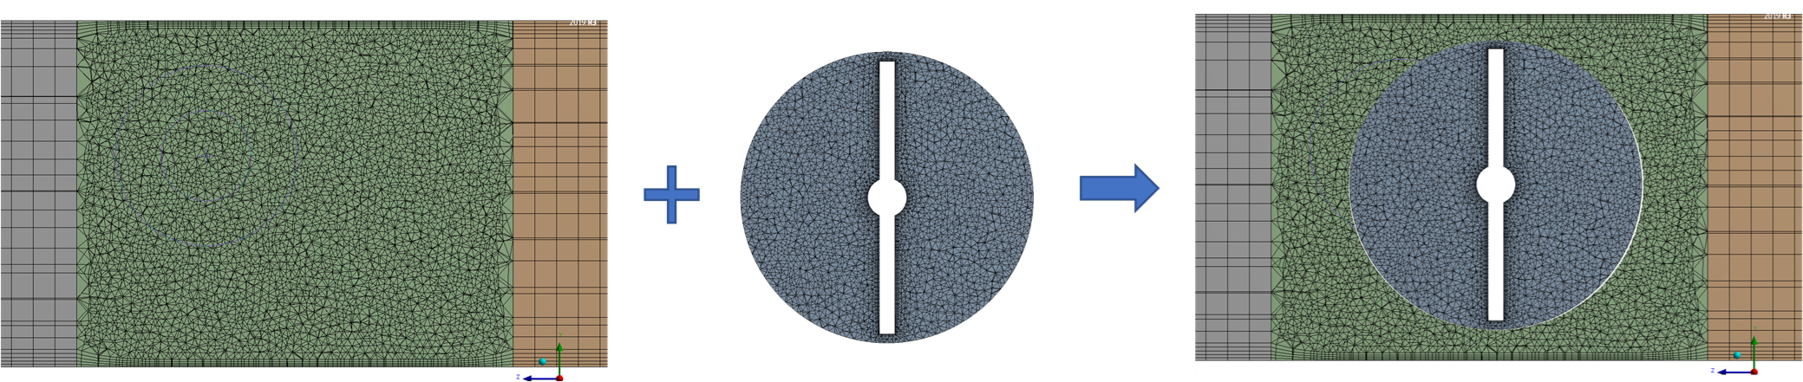
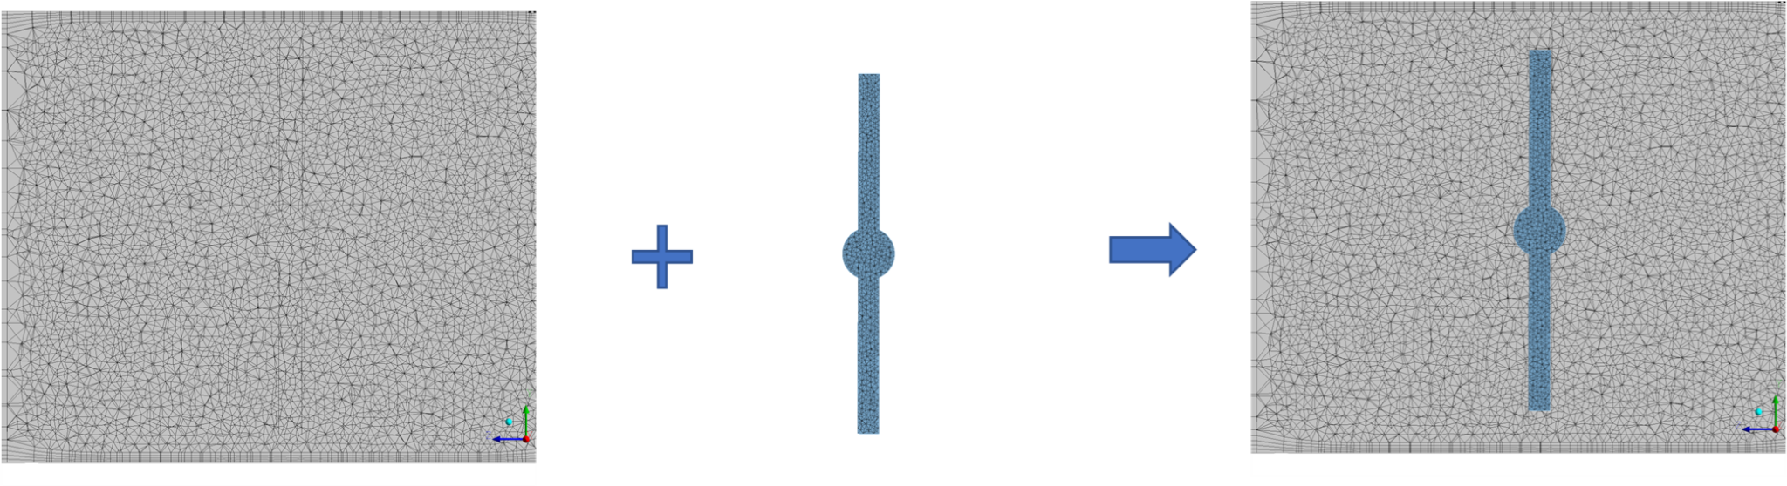

Numerical simulation of Butterfly Valve closing
Mechanical Engineering
Benefits
Future computation models will be built with higher accuracy results.
The simulations will be completed faster, resulting in cost savings.
When many simulations are required, a supercomputer is an advantageous tool.
Company
The Armatury Group specialises mainly in the production of valves, technological units, and related services. The main advantages of their production are their wide range of goods, quality of production and adaptation to customer requirements.
Challenges & Solution
In this collaboration, the primary focus was creating a proof-of-concept, by comparing available Computational Fluid Dynamics Simulation (CFD) approaches to moving objects in fluids.
A comparison of four CFD methods was successfully conducted, providing an overview of the requirements and limitations of each method, as well as the accuracy of the results. The simulations were carried out on a “simplified” flap valve, designed not to limit the use of any of the above-mentioned methods.
Overset mesh method.
Immersed body method.
Full story:
“The use of HPC infrastructure will not only allow computational models to be built with higher accuracy results but also help to complete these simulations in a reasonable time, leading to cost savings. In addition, using supercomputers is advantageous for design optimization when many simulations need to be performed.”
Lukas Kusnir, Research and Development Director of Armatury group
Tomas Karasek, tomas.karasek@vsb.cz
Notes:
*Aeronautics, Agriculture, Automotive, Biotechnology/Bioinformatics, Chemicals, Cosmetics, Construction, Defence sector, Earth science, Electrical and electronic engineering, Energy, Environment/climate/weather, Food and drink, Finance/Insurance, Health care / Pharmaceuticals / Medical devices, IoT (Internet of things), IT/HPC systems, services & software providers, Life sciences, Manufacturing & engineering, Maritime, Material sciences, Mechanical engineering, Public services/Civil protection, Raw materials, metals, minerals and forest-based, Space, Smart City, Textile, Fashion and creative

Slide 25

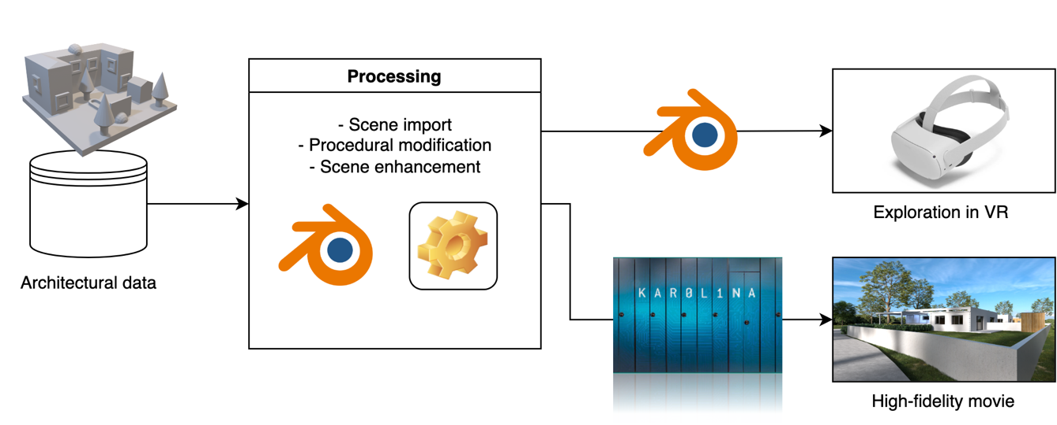

Realistic architectural visualisations using supercomputers
Architecture & Civil Engineering
Company
INFER WAY focuses primarily on designing buildings, public spaces, preparing architectural and urban studies, and designing interiors. In addition to civil and residential buildings, the company also creates single-family houses and various interiors.
Challenges & Solution
The company wanted to develop and verify suitable procedures for processing input architectural data that would enable the generation of visually attractive outputs.
Creating procedures to appropriately modify and augment the 3D scene was necessary to generate photorealistic quality video footage. Furthermore , the scene was modified to allow interactive exportation in VR. In both cases, a path trace rendering was used. A supercomputer was used to achieve fast and accurate rendering outputs.
Benefits
Visualisations of the building design can be highly immersive.
Improvement of the design ideas explanation between the designer and the customer.
Time and cost savings.
Processing workflow applied to architectural data.
Full story:
“Thanks to HPC, it is possible to achieve high visual quality in a fraction of the time compared to rendering on a standard workstation or a set of several workstations. Ideas can be better communicated with the customers, and due to the integration of VR technology in the process, resulting visualisations can be highly immersive.“
Martina Perinkova, CEO of INFER WAY s.r.o.
Tomas Karasek, tomas.karasek@vsb.cz
Notes:
*Aeronautics, Agriculture, Automotive, Biotechnology/Bioinformatics, Chemicals, Cosmetics, Construction, Defence sector, Earth science, Electrical and electronic engineering, Energy, Environment/climate/weather, Food and drink, Finance/Insurance, Health care / Pharmaceuticals / Medical devices, IoT (Internet of things), IT/HPC systems, services & software providers, Life sciences, Manufacturing & engineering, Maritime, Material sciences, Mechanical engineering, Public services/Civil protection, Raw materials, metals, minerals and forest-based, Space, Smart City, Textile, Fashion and creative

Slide 26

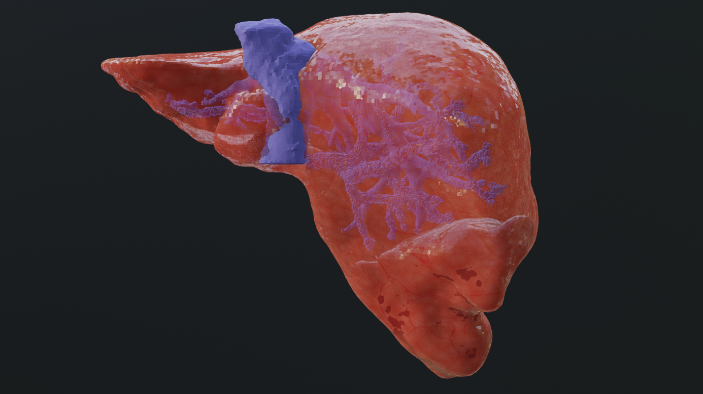

Using supercomputers to create 3D tissue models for visualization
Healthcare
Company
Misterine’s innovative AR and VR solutions enable better visualisation and education through immersive 3D experiences. Their Studio & App help users to effortlessly create, edit, and play AR manuals for a better understanding of complicated manual procedures.
Challenges & Solution
Misterine wanted to create 3D tissue models for visualisation using the supercomputer. Incorporating the new features into Misterine’s existing workflow and ensuring seamless integration with NCC’s workflow while maintaining data integrity presented a significant challenge.
NCC has offered methods to enhance Misterine Studio’s software capabilities to showcase medical tissues in AR and enable workflow execution from the command line.
Benefits
For example, tissue models can be used for AR training from medical image data.
Medical professionals and researchers can study and analyse the tissue more precisely.
The solution will help optimise workflows, reduce complexity, and render realistic images using AR and VR devices.
A 3D liver model that may be viewed in AR/VR.
Full story:
“Thanks to using supercomputers, it has been possible to reduce the time of AI model training from computed tomography (CT) datasets. This will help Misterine with advanced data processing capabilities with deep learning.”
Martin Klima, CTO of Misterine s.r.o.
Tomas Karasek, tomas.karasek@vsb.cz
Notes:
*Aeronautics, Agriculture, Automotive, Biotechnology/Bioinformatics, Chemicals, Cosmetics, Construction, Defence sector, Earth science, Electrical and electronic engineering, Energy, Environment/climate/weather, Food and drink, Finance/Insurance, Health care / Pharmaceuticals / Medical devices, IoT (Internet of things), IT/HPC systems, services & software providers, Life sciences, Manufacturing & engineering, Maritime, Material sciences, Mechanical engineering, Public services/Civil protection, Raw materials, metals, minerals and forest-based, Space, Smart City, Textile, Fashion and creative

Slide 27

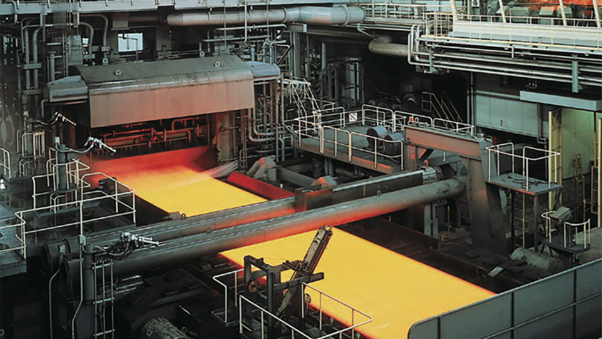

Neural networks in the steel industry
Manufacturing & Engineering
Company
ITA technology & software company supplies know-how and software solutions to leading major producers of rolling equipment, technologies, and control systems. Many of their software solutions have been successfully installed in rolling mills worldwide.
Challenges & Solution
Among the objectives of the collaboration was to investigate the possibility of using machine learning and neural networks to predict the accurate cooling parameters in steel rolling manufacturers' processes.
Having the correct parameters is essential for ensuring the final product's quality. The aim is to replace the need for manual correction with automatic correction based on AI methods.
The solution was analyzed and verified if the predictions generated by the ML models can enhance the methods currently used by ITA.
Benefits
Artificial intelligence allows more accurate temperature calculations.
An automated correction based on AI can calculate the estimated belt temperature after cooling more accurately and make the entire cooling process more efficient.
Time and, therefore costs can be saved.
Ilustration of the steel sheet cooling process.
Full story:
“The collaboration with IT4Innovations and the use of machine learning methods have been very beneficial for us, as the deployment of artificial intelligence allows for more accurate temperature calculations. Among the time and cost savings, I would also like to highlight the positive environmental impact thanks to the optimized cooling process.”
Daniel Hajduk, ITA, spol. s r.o. Executive Manager
Contact person at the NCC: Tomas Karasek, tomas.karasek@vsb.cz
Notes:
*Aeronautics, Agriculture, Automotive, Biotechnology/Bioinformatics, Chemicals, Cosmetics, Construction, Defence sector, Earth science, Electrical and electronic engineering, Energy, Environment/climate/weather, Food and drink, Finance/Insurance, Health care / Pharmaceuticals / Medical devices, IoT (Internet of things), IT/HPC systems, services & software providers, Life sciences, Manufacturing & engineering, Maritime, Material sciences, Mechanical engineering, Public services/Civil protection, Raw materials, metals, minerals and forest-based, Space, Smart City, Textile, Fashion and creative

Slide 28

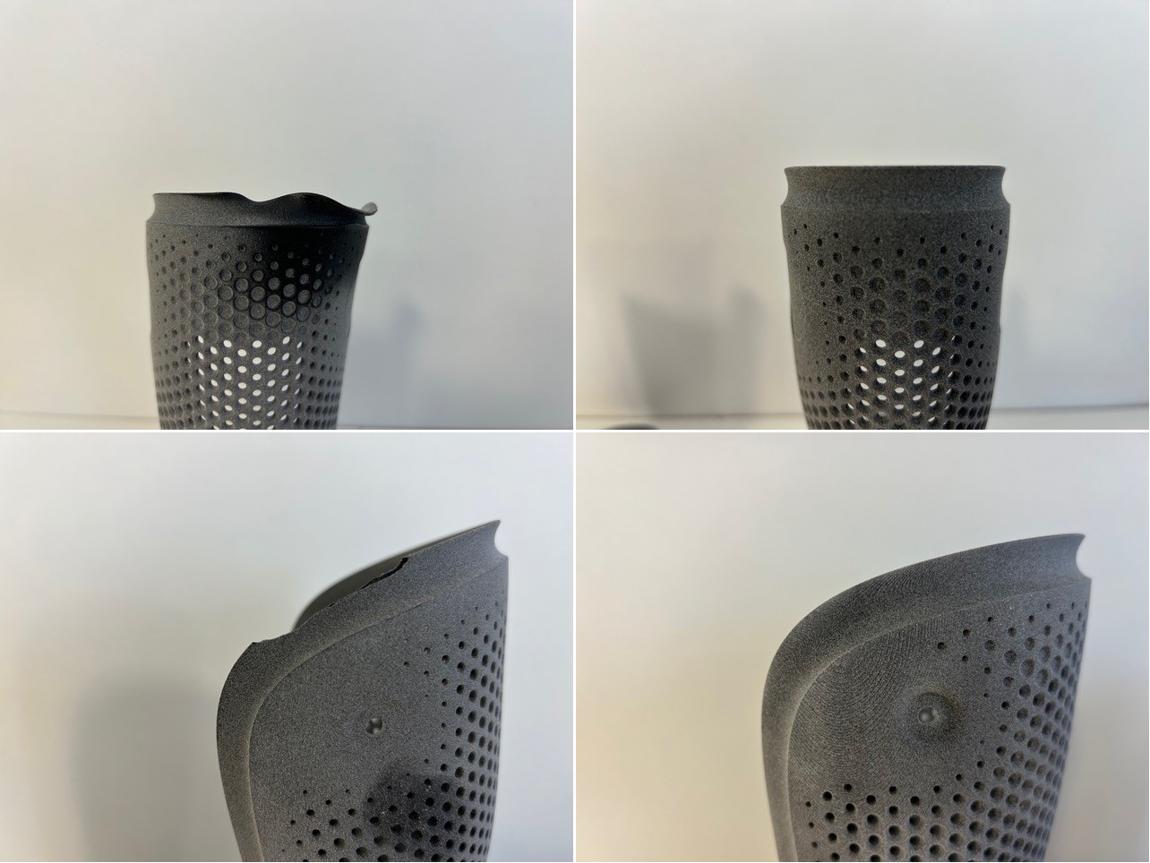

Estimation of product defects using supercomputers
Biotechnology
Healthcare
Company
The ING Corporation develops, designs, and manufactures medical devices using modern technologies such as 3D printing, CNC machines, and advanced materials. It is one of the leading companies on the Czech market in prosthetics.
Challenges & Solution
The main goal was to develop and verify effective procedures for analysing the shape of manufactured products, especially focusing on identifying possible inaccuracies. Implementing machine vision instead of manual check by an expert can offer a significantly more efficient and accurate approach.
Using descriptive points and relevant information that describe the product, the solution algorithm calculates the manufacturing error rate.
Benefits
Algorithm calculates the manufacturing error rate by comparing the final product to its proposed construction.
Verification of the product’s shape if it meets the standards.
Proposed solution can make production more efficient thanks to the possibility of detecting non-conforming products.
The first column shows two different types of product deformation. As you can see, the shape of the product is damaged. The next column shows the final product that meets the quality standards.
Full story:
“The proposed solution can make production more efficient thanks to the possibility of detecting non-conforming products. In the next phase, it would be possible to use the results to identify problematic parts of the product design itself. It would further improve the efficiency of the entire design-manufacturing process.“
Jiri Rosicky, CEO of ING corporation
Tomas Karasek, tomas.karasek@vsb.cz
Notes:
*Aeronautics, Agriculture, Automotive, Biotechnology/Bioinformatics, Chemicals, Cosmetics, Construction, Defence sector, Earth science, Electrical and electronic engineering, Energy, Environment/climate/weather, Food and drink, Finance/Insurance, Health care / Pharmaceuticals / Medical devices, IoT (Internet of things), IT/HPC systems, services & software providers, Life sciences, Manufacturing & engineering, Maritime, Material sciences, Mechanical engineering, Public services/Civil protection, Raw materials, metals, minerals and forest-based, Space, Smart City, Textile, Fashion and creative

Slide 29

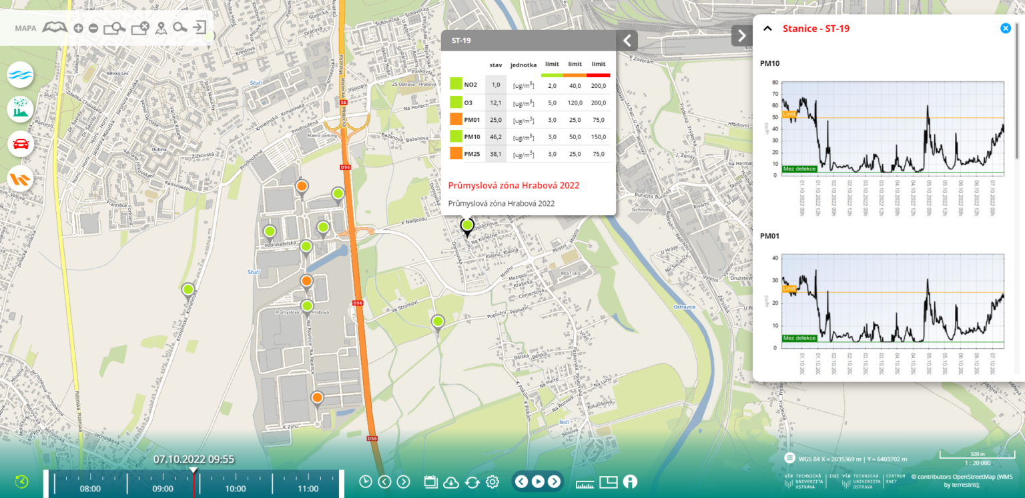

System for intelligent identification of air pollution sources
Environment
Company
ENVItech Bohemia focuses on offering comprehensive services in the field of environmental monitoring, especially of air - the company's main focus is the measurement of concentrations of pollutants. They supply a comprehensive assortment of means for monitoring air quality, including management systems.
Challenges & Solution
The aim of the cooperation between ENVItech and the VSB – Technical University of Ostrava institutes CEET and IT4Innovations was the implementation of the “Intelligent Air Pollution Source Identification System” (IIS) based on the principle of an online model of short-term values of concentrations of selected, health-relevant substances.
A comprehensive system for monitoring emission loads and software for evaluating and interpreting air pollution was acquired, emphasizing effective use for strategic decision-making in state administration, self-administration, and industrial resource management.
Benefits
Moravian-Silesian Region and the Ministry of the Environment have obtained a tool for fast, large-scale and cheap measurements of air pollution changes.
Easy-to-use graphical interface for an average users integrating data from different thematic areas.
Plug&Play system architecture enabling the simple integration of new sensors and automatic data processing and visualisation.
View of the software evaluating and interpreting air pollution.
Full story:
“In order to evaluate the effectiveness of the decarbonization of the region and the impact of low-carbon technologies on the environment and society, it is necessary to assess the state of air quality before and after their implementation. Therefore, the creation of an intelligent identification system of air pollution sources was absolutely necessary.“
Stanislav Misak, Director of the CEET at VSB – Technical University of Ostrava
Tomas Karasek, tomas.karasek@vsb.cz
Notes:
*Aeronautics, Agriculture, Automotive, Biotechnology/Bioinformatics, Chemicals, Cosmetics, Construction, Defence sector, Earth science, Electrical and electronic engineering, Energy, Environment/climate/weather, Food and drink, Finance/Insurance, Health care / Pharmaceuticals / Medical devices, IoT (Internet of things), IT/HPC systems, services & software providers, Life sciences, Manufacturing & engineering, Maritime, Material sciences, Mechanical engineering, Public services/Civil protection, Raw materials, metals, minerals and forest-based, Space, Smart City, Textile, Fashion and creative

Slide 30

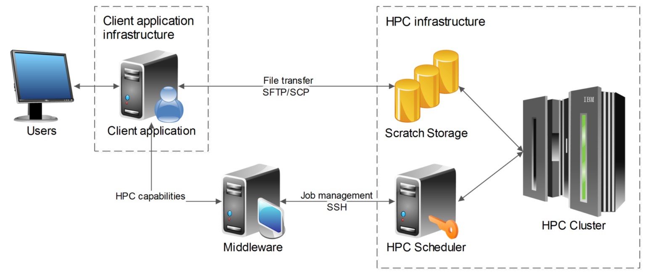

Easy and secure access to HPC infrastructure for scientists through HEAppE
Healthcare
Company
Politecnico di Milano is a public scientific-technological university that trains engineers, architects, and industrial designers.
Challenges & Solution
During the COVID-19 pandemic, the university wanted its scientists and researchers to access HPC infrastructure easily without installing additional software. The solution should allow them to continue their research on possible cures for COVID-19.
The collaboration led to developing a client environment application based on the web-based interactive computing platform Jupiter Notebook. It allows for the creation and management of HPC executions using HEAppE Middleware. Additionally, the client environment offers the choice of a language (C# or Python), depending on the research activity.
Benefits
The solution enables to continue research using HPC infrastructure remotely even during isolation.
Can help further accelerate the computational process in case of future pandemics.
Installation of additional software is not necessary.
Choice of a language is possible.
Visualisation of the connection between the user and HPC Cluster through the client environment.
Full story:
“Within the project Exscalate4COV, we virtually screened more than 70 billion molecules as possible drugs against Sars-CoV-2. This is where supercomputers make all the difference, facilitating the rapid selection of only the most promising molecules for subsequent phases of the drug discovery pipeline.“ Gianluca Palermo, Professor at Politecnico di Milano
Tomas Karasek, tomas.karasek@vsb.cz
Notes:
*Aeronautics, Agriculture, Automotive, Biotechnology/Bioinformatics, Chemicals, Cosmetics, Construction, Defence sector, Earth science, Electrical and electronic engineering, Energy, Environment/climate/weather, Food and drink, Finance/Insurance, Health care / Pharmaceuticals / Medical devices, IoT (Internet of things), IT/HPC systems, services & software providers, Life sciences, Manufacturing & engineering, Maritime, Material sciences, Mechanical engineering, Public services/Civil protection, Raw materials, metals, minerals and forest-based, Space, Smart City, Textile, Fashion and creative

Slide 31
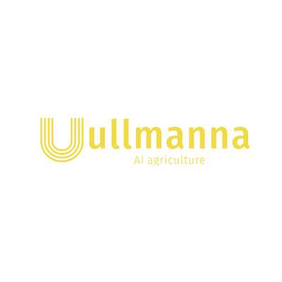
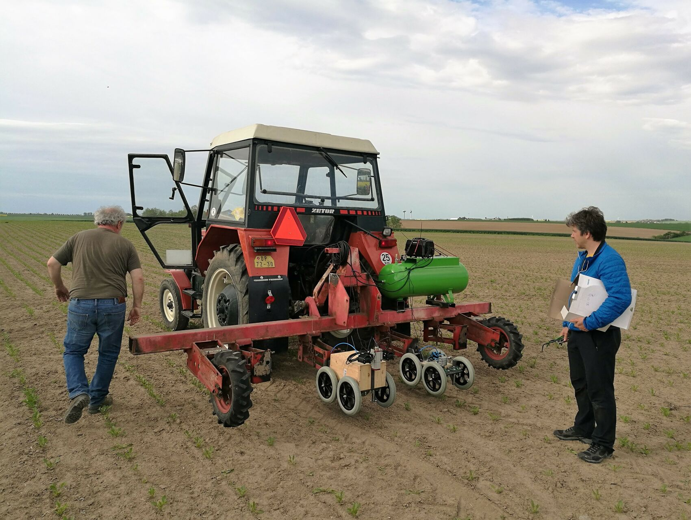

Weed detection – weeding machine
Agriculture
Company
Family-run tech startup Ullmanna develops an agricultural weeding machine that recognizes the target crop using machine learning and enables in-line weed control.
Challenges & Solution
The main challenge was identifying crops automatically, in this case sugar beets, from weeds. By recognizing the crops, the weeding machine will be able to remove the weeds without damaging them.
Direct deployment on the weeding machine places additional demands on the technology regarding HW and recognition speed.
By using machine learning, we were able to solve this challenge. To accomplish this goal, a neural network was created and trained.
Benefits
The weeds can be removed while not damaging the crop grown.
Farming activities without the use of chemical sprays.
Positive impact on the environment and society.
Enables an increase in food production without the usage of pesticides.
Agricultural weeding machine device for recognition of the target crop from weed.
Full story:
“Our intended product has a significant positive impact on the environment and society – it enables an increase in food production without the use of pesticides that negatively affect both the environment and human health.”
Martin Ullmann, Chief Executive Officer, Co-founder, Ullmanna
Tomas Karasek, tomas.karasek@vsb.cz
Notes:
*Aeronautics, Agriculture, Automotive, Biotechnology/Bioinformatics, Chemicals, Cosmetics, Construction, Defence sector, Earth science, Electrical and electronic engineering, Energy, Environment/climate/weather, Food and drink, Finance/Insurance, Health care / Pharmaceuticals / Medical devices, IoT (Internet of things), IT/HPC systems, services & software providers, Life sciences, Manufacturing & engineering, Maritime, Material sciences, Mechanical engineering, Public services/Civil protection, Raw materials, metals, minerals and forest-based, Space, Smart City, Textile, Fashion and creative

Slide 32
Estonia

Slide 33

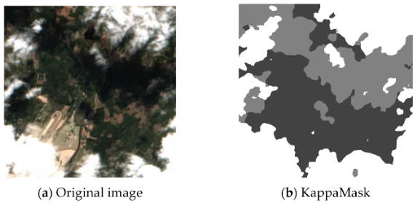


An accurate AI-based Cloud Mask Processor for Sentinel-2
Agriculture
Company
KappaZeta is a remote sensing company with expertise in using radar satellite data, incorporating it with optical satellite data and providing some of the most accurate AI models on the market.
Challenges & Solution
Cloud masking is an essential step for the pre-processing of optical satellite imagery. KappaZeta addresses the problem by introducing KappaMask, an AI-based cloud and cloud shadow masking processor that uses a large convolutional segmentation model. Faster model convergence during training can be achieved by using larger batch sizes of the training data, which means more GPU memory is needed.
KappaMask was trained on an open-source dataset and fine-tuned on a Northern European terrestrial dataset which was labelled manually using the active learning methodology.
Benefits
Reliable cloud mask processor for Northern Europe region, which is compatible with ESA Sentinel-2 L2 processing chain
Creation of high quality reference dataset for future developments
Innovative application of deep learning techniques in cloud masking
Comparison of L2A prediction output for a 512 × 512 pixels sub-tile in the test dataset.
(a) Original Sentinel-2 L2A True-Colour Image; (b) KappaMask classification map.
“We compared KappaMask v2 with other cloud masking processors including Sen2Cor, Fmask, MAJA, IdePix and S2Cloudless on the challenging and diverse test set. KappaMask v2 demonstrated exceptional performance reaching the highest accuracy and outperforming all the above-mentioned methods.” Tetiana Shtym, machine learning engineer @ KappaZeta
Full story:
Ülar Allas, EuroCC EE, ylar.allas@ut.ee

Slide 34

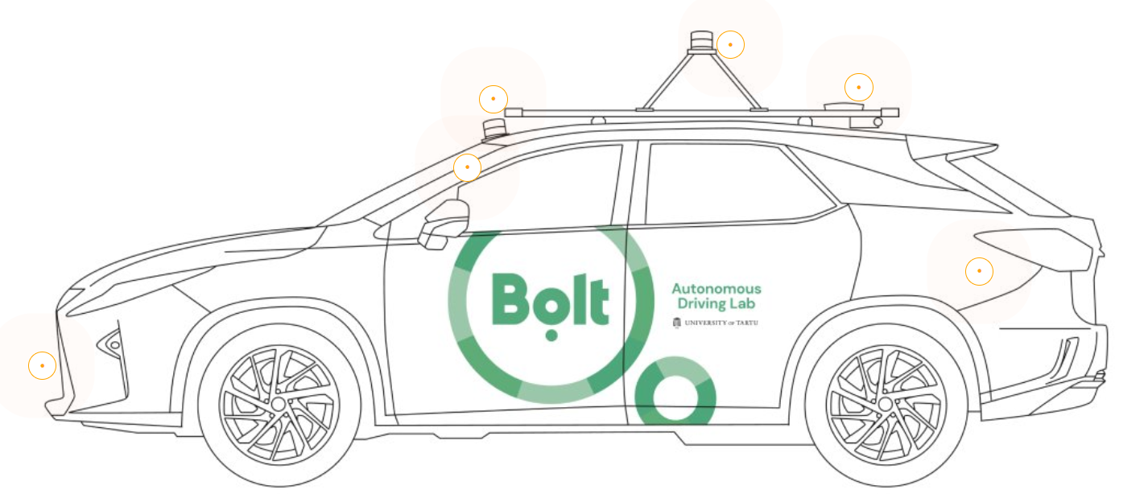
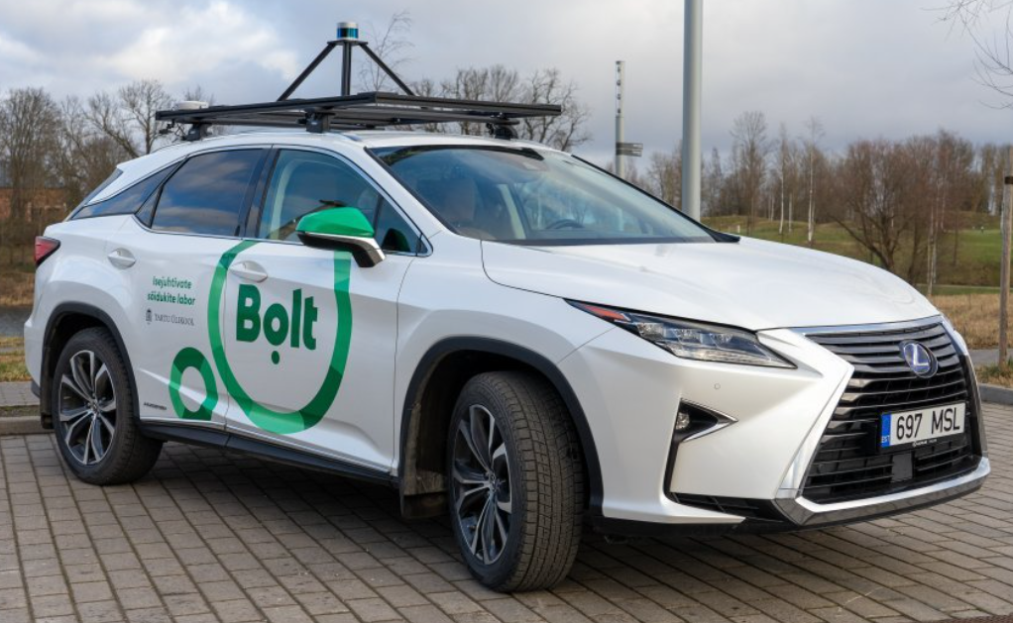

Self-driving Technology Research in partnership with the University of Tartu
Autonomous Vehicles
Company
Bolt is an Estonian mobility company that offers vehicle for hire, micro mobility, car-sharing, and food delivery services headquartered in Tallinn and operating in over 400 cities in over 45 countries. In partnership with the University of Tartu, the company develops self-driving technology for a Level 4 autonomous car.
Challenges & Solution
Autonomous cars acquire up to 357 GB/hour of data during test drives. Autonomous car engineers needed a system to store and easily access those test logs.
Acquired test logs are copied to HPC storage, into appropriately guarded directory. Regularly cron job processes those log files into metadata stored in MongoDB database. Processing is distributed over cluster and happens in parallel. Longest logs can take up to 24 hours to process, so processing them sequentially would be very time-consuming. On top of MongoDB sits custom-made application that allows filtering of test sessions and browsing them using Webviz visualization tool. Visualization tool accesses the raw sensor data from HPC storage.
Benefits
 Custom database application and visualization tool enables easy analysis of the logs
Thanks to distributed processing in the cluster the metadata about the drives usually shows up already next morning
Thanks to petabytes of storage at the HPC Centre, the company can keep all the data they need
Lexus RX450h equipped with the sensors that are a prerequisite for basic autonomy.
Full story:
“Thanks to custom database application and visualization tool the team members can easily analyze the logs and share their findings with each other” Tambet Matiisen, Operations coordinator @Bolt
Ülar Allas, EuroCC EE, ylar.allas@ut.ee

Slide 35

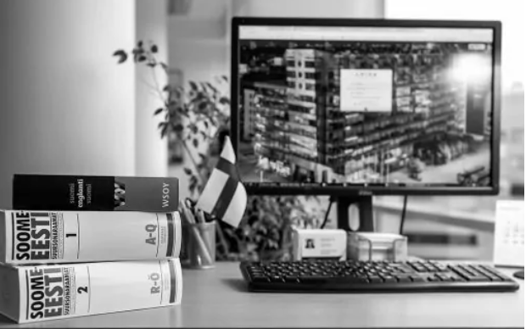
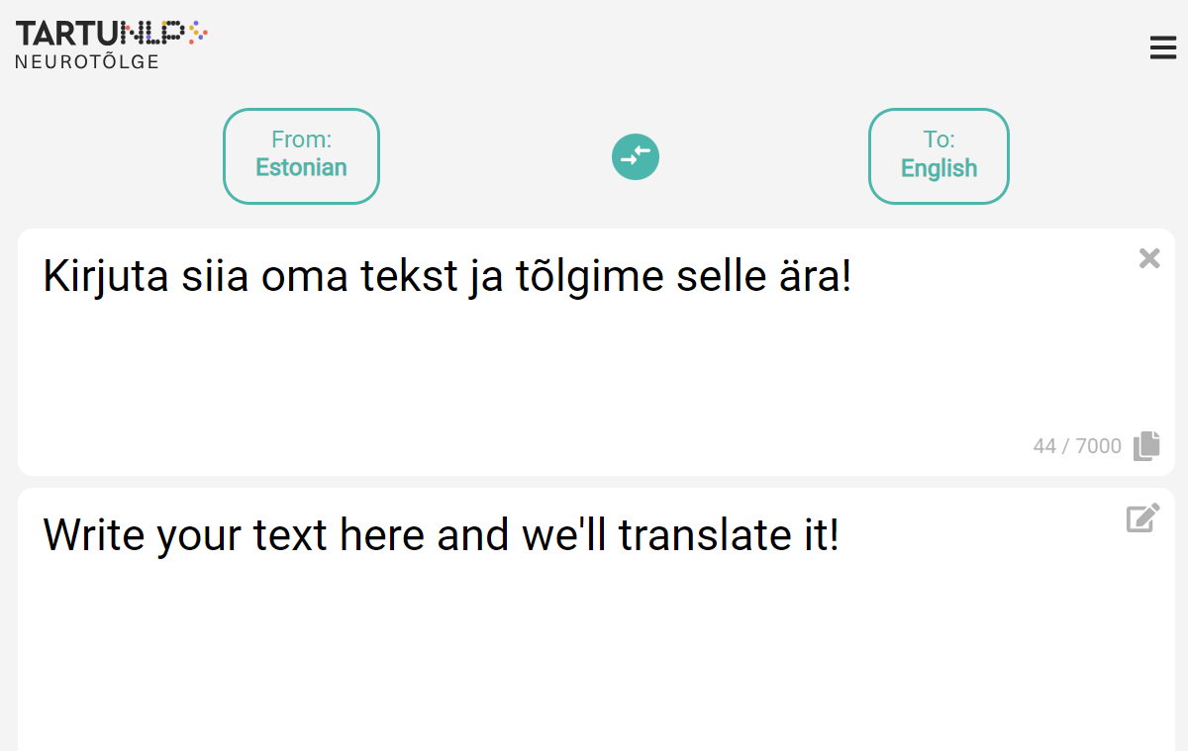

Machine Translation Post-Editing
Humanities/ Languages technology
Company
Luisa Tõlkebüroo OÜ is the biggest translation agency in Estonia. The company offers more than 50 services – including sworn translation, simultaneous and consecutive interpretation, layout work, machine translation and post-editing, subtitling and localisation.
Challenges & Solution
The company needed a custom-made machine translation system to reduce the time of translations. As the company had no previous experience neither in natural language processing nor in machine learning, they collaborated with the TartuNLP team. Training of the machine translation model was conducted by using University of Tartu HPC centre’s Rocket cluster.
Once the models were trained, the company considered different options for deployment. Their initial plan was to invest in their own infrastructure but soon they realized that it would not be justified for their use case and the TartuNLP group deployed the models alongside other services in the cloud.
Benefits
 Neural machine translation systems were built for 4 language pairs and several text domains
The company enjoyed lower deployment costs and did not have to worry about maintaining their own hardware
The innovative translation tool helps to save valuable time and human resources
Screenshot of the translation engine developed by TartuNLP.
Full story:
“Thanks to rapid advances in the technology and our extensive translation memory, we are able to offer our clients machine translations with post-editing in a range of language combinations and on a range of topics.” Anna Räbokon, Customer Relations Manager @Luisa Tõlkebüroo OÜ
Ülar Allas, EuroCC EE, ylar.allas@ut.ee

Slide 36
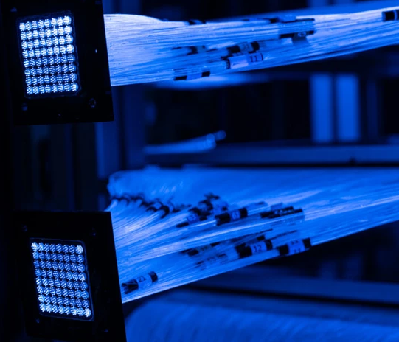

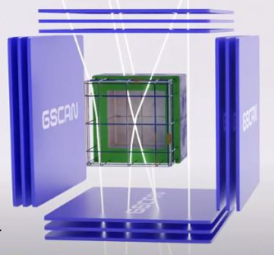
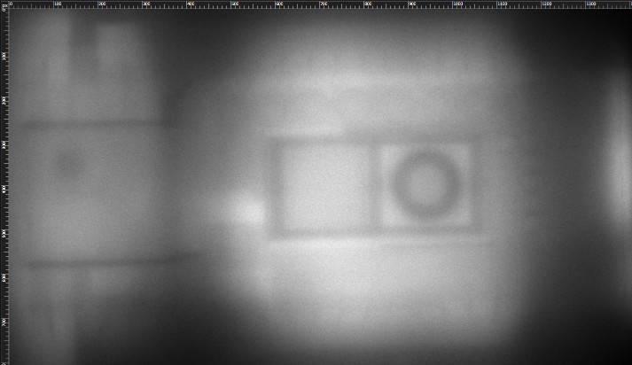

Cosmic Ray-based Solutions for 3D Imaging
Construction
(3D Scanning)
Company
GScan was founded in 2018 to revolutionize inspection, security and medical scanning markets using Muon Flux Technology (MFT). GScan, as the pioneer of MFT having unique IP, tech & sales know-how in the field, is developing a new generation of Non-Destructive Testing (NDT) scanners and tomography systems for infrastructure management applications.
Challenges & Solution
To keep the surrounding environment safe and ensure their longevity, careful assessment, maintenance and investment plan is required. However, currently there is no efficient way of obtaining the information required for more efficient use of assets and reducing risks for critical infrastructure.
Using cosmic ray tomography, the technology monitors particle trajectory changes, extracting vital statistics about material and shape. This data is transformed into 2D and 3D visualizations, including internal and external geometries and chemical composition. The comprehensive delivered output provides in-depth insights into the objects and materials under scrutiny. HPC plays an important role in translating the collected data into visualizations.
Benefits
Acceleration of data processing and reconstructions.
Application of a broader range of algorithms during the post-processing.
Provision of more reliable data about critical infrastructure for a safer world.
A reconstructed model of a temporarily decommissioned nuclear submarine. The horizontal plane slice covers 15x9 m area, which in total consists of 135 0000 points of interest (pixels), and is one out of 900 slices that were processed during the post-processing of measurement
Full story:
«With time and space related digital data in terabytes, the detailed process of reconstruction enables us to see inside of structures what was not possible before. » Sander SEIN, PROJECT MANAGER GSCAN
Sander SEIN, PROJECT MANAGER GSCAN
Ülar Allas, EuroCC EE, ylar.allas@ut.ee

Slide 37
France

Slide 38

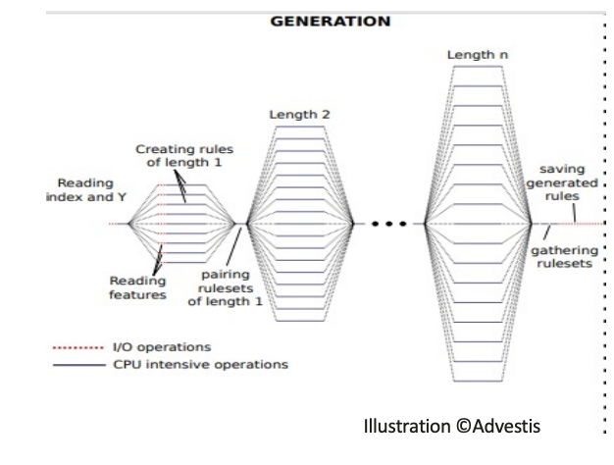


Data science & Machine Learning Development of prediction and investment rules
Finance
Company
Since its creation in 2011 in Paris, Advestis part of Mazars offers services of applied research in data science and put into production some machine learning systems.
Challenges & Solution
Advestis has developed an artificial intelligence algorithm capable of generating interpretable investment rules, based on data from financial results. Even filtered, the number of generated rules remains significant and the restitution time of the algorithm was too high.
Criann’s HPC engineer accompanied the R&D team of Advestis in the optimization and execution of the algorithm, coded in Python, and using the package mpi4py for parallelization.
Benefits
Restitution times have been divided by 20, which results in a very clear reduction in the costs of calculation.
Improved prediction quality and increased financial performance.
Generation of rules, illustration © Advestis
Full story:
“The assistance from CRIANN, both for handling the calculation nodes and for advice on optimizing the code, was of very good quality and allowed us to progress very quickly. »
Philippe COTTE, LEAD PYTHON ENGINEER, Advestis part of Mazars
Marie-Sophie CABOT, Industry Euro CC FR, Marie-Sophie.Cabot@criann.fr
Notes:
*Aeronautics, Agriculture, Automotive, Biotechnology/Bioinformatics, Chemicals, Cosmetics, Construction, Defence sector, Earth science, Electrical and electronic engineering, Energy, Environment/climate/weather, Food and drink, Finance/Insurance, Health care / Pharmaceuticals / Medical devices, IoT (Internet of things), IT/HPC systems, services & software providers, Life sciences, Manufacturing & engineering, Maritime, Material sciences, Mechanical engineering, Public services/Civil protection, Raw materials, metals, minerals and forest-based, Space, Smart City, Textile, Fashion and creative

Slide 39

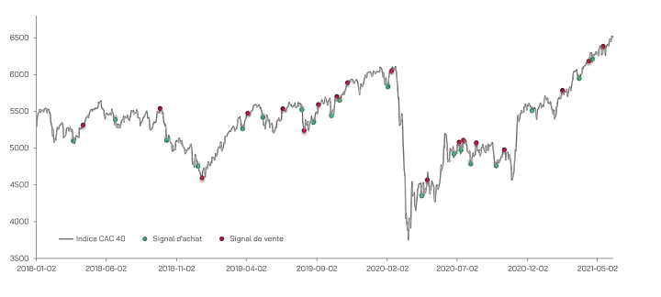

Independent portfolio management company part of the Ecole Polytechnique incubator nursery
Finance
Company
Created in 2021, Horae Technology offers investment solutions for individuals and institutions.
Challenges & Solution
Horae Technology is developing an innovative decision support tool combining artificial intelligence and behavioral finance. In September 2021, Horae Technology joined the Euro-CC program, in order to benefit from high-level support in intensive computing.
This computing power has notably enabled the company to accelerate the performance of its tool via the parallelization of its code and the possibility of analyzing thus thousands of financial securities simultaneously.
Benefits
Improve the calculation time of training algorithms
Significantly increase the power and robustness of the AI models.
Retroactive evaluation of buy and sell signals on the CAC 40 index
Full story:
Individual and personalized support allowed the company to quickly become autonomous in the use of the supercomputer.
Marie-Sophie CABOT, Industry Euro CC FR, Marie-Sophie.Cabot@criann.fr

Slide 40

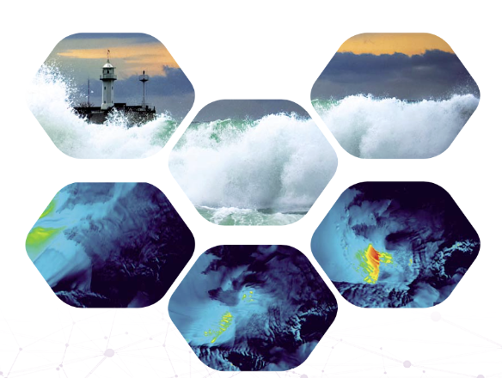

How to provide a statistically significant set of data of extreme weather events
Environmental risks & Insurance
Company
RiskWeatherTech supports its institutional and private customers in the risk management and the study of the vulnerability of territories and businesses.
Challenges & Solution
Faced with the recurrence of intense weather disturbances in France, Risk Weather Tech has developed, thanks to Myria supercomputer at Criann, a vast catalog of storms physically and statistically plausible. Main objectives: anticipate potential damage on infrastructure and map more precisely the risks of insurance claims.
Proof of concept that were achieved
- Building a database of climate events
- Accurate mapping of claims risks
Benefits
Simulation of 10,000 realistic storms that could occur in France
More than 870,000 CPU hours was needed
Exemple of an extreme weather event
Full story:
The catalogue of 10,000 storms is a tool for the insurance industry to analyse the risks associated with storms in France
Marie-Sophie CABOT, Industry Euro CC FR, Marie-Sophie.Cabot@criann.fr

Slide 41
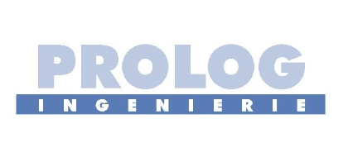



Opening of public bathing sites in the natural environment
Environment water quality
Company
The PROLOG INGÉNIERIE group, an independent consultancy engineering firm, in the field of water and associated remotely managed systems, works to improve water quality.
Challenges & Solution
How to succeed in opening swimming sites in Marne after the Paris 2024 Olympic Games? To support the management plans put in place by public authorities in these highly urbanized areas, Prolog engineering has developed a model coupling hydrodynamics and water quality on the Criann supercomputer.
Proof of concept that were achieved :
- 3D hydrodynamic simulation of a section of the river Marne with consideration of pollution sources
- Deployment on HPC architecture
- Getting started with the HPC environment
Benefits
Speed of calculation time
Fine representation of pollution dispersion
More than 120,000 CPU hours was needed
Fine modeling of the dispersion of bacteriological strains from their point of emission
Full story:
Numerical simulation and HPC in support to public authorities for management plans
Marie-Sophie CABOT, Industry Euro CC FR, Marie-Sophie.Cabot@criann.fr

Slide 42



AI medical device software to quantify brain damage and clinical prognosis
Healthcare
Company
Braintale is an innovative company dedicated to deciphering the white substance to allow better treatment in neurology and intensive care with prognostic solutions clinically validated.
Challenges & Solution
Braintale has joined the Euro-CC program, in order to benefit from high-level support in supercomputing
This computing power has notably enabled the company to analyze in efficient conditions the data of more than 500 patients in order to develop its research tools to optimize the intake in charge of brain diseases
Benefits
Optimization of retrospective analysis of large research cohorts
Intensive processing of very large volumes of data
Measurements of brain white-matter microstructure alterations
Full story:
HPC for the development of an innovative medical device that will benefit to patients, medical professionals and researchers
Marie-Sophie CABOT, Industry Euro CC FR, Marie-Sophie.Cabot@criann.fr

Slide 43



Multi-scale and multiphysics simulation of a dam on HPC architecture
Engineering
Company
CEVAA, part of the 6NAPSE Group, is an engineering office specialized in acoustics and mechanics, with a range of expertise and testing facilities for Industry.
Challenges & Solution
CEVAA was requested to study the mechanical performance of a dam. With length scales ranging from centimeter to several tens of meters, consideration of multiphysics loadings (temperature, pressure, efforts), the internal calculation resources of the company were clearly insufficient to conduct the study.
The study was carried out on the Myria supercomputer of CRIANN with Code_Aster software for calculations and Salome-Meca for meshing and post-processing.
- installing the latest versions sequential and parallel of Code_Aster
- help with creating scripts launch of calculations.
Benefits
HPC expertise
Solve client projects with a significant productivity gain
Results of mode shapes on a dam
Full story:
For CEVAA project, the support consisted in installing the latest sequential and parallel versions of Code_Aster, and providing scripts for calculation launches.
Marie-Sophie CABOT, Industry Euro CC FR, Marie-Sophie.Cabot@criann.fr

Slide 44
Hungary

Slide 45






Tengr.ai revolutionizes the creative industry using Komondor
Fashion and creative
Company
Tengrai Artificial Intelligence kft. was founded in 2023 with the goal of creating a European image-generation startup. It has already released a free-to-use image generation to the public, while video- and web generation is in the proof-of-concept stage.
Challenges & Solution
The biggest challenge was to create a solution that creates images at least as good as the American competitors while following the privacy-by-design philosophy that does not have gender or racial bias. It needs to easily "forget" styles if there are copyright claims for parts of the training dataset. Moreover, the founders were living during communist regimes, so they are against censorship while also forbidding illegal content generation.
Benefits
Enable everyone to express their creative freedom
Replace overused and boring stock photos
Easy-to-use and accessible image generation
Multilingual and multicultural, without racial or gender bias
Video and website generation
Full story:
“KIFÜ enabled this project through Komondor HPC; without their help and support, the Tengr.ai project would not stand a chance in this highly competitive and fast-paced environment.”
Peter W. Szabo, Founder and researcher @Tengrai Artificial Intelligence kft.
Erzsébet Horváth Governmental Agency for IT Development-KIFÜ, horvath.erzsebet@kifu.gov.hu
Notes:
*Aeronautics, Agriculture, Automotive, Biotechnology/Bioinformatics, Chemicals, Cosmetics, Construction, Defence sector, Earth science, Electrical and electronic engineering, Energy, Environment/climate/weather, Food and drink, Finance/Insurance, Health care / Pharmaceuticals / Medical devices, IoT (Internet of things), IT/HPC systems, services & software providers, Life sciences, Manufacturing & engineering, Maritime, Material sciences, Mechanical engineering, Public services/Civil protection, Raw materials, metals, minerals and forest-based, Space, Smart City, Textile, Fashion and creative

Slide 46





Machine learning aided geospatial data acquisition
Smart City
Company
InterMap has 24 years of experience developing hardware and software solutions for collecting, managing and sharing geospatial data, employing most recent advances in the mapping and IT fields, assisting the job of surveyors, municipalities and infrastructure planners.
Challenges & Solution
To acquire accurate and useful data with the least possible manual labour, efficient machine learning models must be trained. These training sessions require vast amount of computer resources.
By employing HPC resources, the training time can be significantly reduced, thus more experimental solutions can be examined. Furthermore, with more processing capability, more complex models can be trained, which opens up new data acquisition methods.
Benefits
Faster training of experimental models
Scalable resource allocation to match model complexity
Parallel processing results in more generic models
Image processing results on ground survey images, from which spatial data can be generated.
Full story:
“We were able to deploy our training pipeline to the Komondor HPC, provided by the KIFÜ and the results are the expected: more complex image processing models can be trained in much less time, which would not be possible on consumer-grade hardware.”
Gergő Tóth, Technology developer @InterMap
Katalin Kelemen Governmental Agency for IT Development-KIFÜ kelemen.katalin@kifu.gov.hu
Notes:
*Aeronautics, Agriculture, Automotive, Biotechnology/Bioinformatics, Chemicals, Cosmetics, Construction, Defence sector, Earth science, Electrical and electronic engineering, Energy, Environment/climate/weather, Food and drink, Finance/Insurance, Health care / Pharmaceuticals / Medical devices, IoT (Internet of things), IT/HPC systems, services & software providers, Life sciences, Manufacturing & engineering, Maritime, Material sciences, Mechanical engineering, Public services/Civil protection, Raw materials, metals, minerals and forest-based, Space, Smart City, Textile, Fashion and creative

Slide 47
Latvia

Slide 48




Topological optimization using HPC for medical devices
Health care / Pharmaceuticals / Medical devices
Benefits
• 20% reduction in labor hours for cast design, which also reduces the risk of human error.
• Approximately 25% reduction in production material use through topological optimization.
• 25% reduction in production time through material optimization and shorter printing durations.
• Up to 15% reduction in production costs.
• Up to 25% enhanced production capacity at CastPrint.
Company
CastPrint is a Latvian SME that provides clinics with custom-made 3D printed casts for wrist, finger, leg fractures. The casts are lighter and more breathable than the traditional gypsum fixtures.
Challenges & Solution
The Challenge
Creation of a 3D printed cast is a time-consuming and resource intensive process. Since the 3D scans used for production contain huge numbers of surface elements, processing the data on typical office computers is both slow and often unreliable, with software crashes resulting in data loss and delayed delivery to patients.
The Solution
Integrating parametric model optimization into the design process of the medical device. This involves using simulations to determine the most efficient shape for the cast, which in turn reduces the amount of material required and shortens printing times.
The use of HPC enables faster and more effective simulations, automating certain aspects of the design process and ultimately reducing the time spent on it.
Full story:
“There are many challenges in the production of fixators. The most important ones – how to shorten production time? how to reduce manual steps? how to save 3D printing times? These challenges also had a solution: parametric model optimization and HPC technology.”
Janis Olins, CEO @CastPrint
NCC Logo + QR code (incl. website to the complete story)
Contact person at the NCC: Karlis Muiznieks, karlis.muiznieks@lu.lv
Notes:
*Aeronautics, Agriculture, Automotive, Biotechnology/Bioinformatics, Chemicals, Cosmetics, Construction, Defence sector, Earth science, Electrical and electronic engineering, Energy, Environment/climate/weather, Food and drink, Finance/Insurance, Health care / Pharmaceuticals / Medical devices, IoT (Internet of things), IT/HPC systems, services & software providers, Life sciences, Manufacturing & engineering, Maritime, Material sciences, Mechanical engineering, Public services/Civil protection, Raw materials, metals, minerals and forest-based, Space, Smart City, Textile, Fashion and creative

Slide 49



AI algorithm for molecule recognition
Health care / Pharmaceuticals / Medical devices
Company
Semantic Intelligence has developed an AI-driven IP Intelligence Engine enables scientists & IP experts to search, analyze and extract complex knowledge on chemical-biological interactions
Challenges & Solution
Challenge
How to index molecular images quickly & efficiently to provide users with the fastest possible access to current, published patents? The data base is one of the largest patent databases: USPTO (United States Patent and Trademark Office) with 5 million patent documents, more than 50 million molecules.
Solution
AI algorithm training in molecule recognition & integration into existing data processing workflow.
Benefits
Successfully completed algorithm training on the database
Confidence in the effectiveness of the HPC center infrastructure and process
Expected time & cost saving benefits (~20-30%)
Full story:
“Use of HPC allows us to perform a completely new approach to rapid analysis of big data in biopharmaceuticals, combining both structured and unstructured data to provide a data-driven, critical decision-making process to our clients.”
Vita Sture, CEO @Semantic Intelligence
Contact person at the NCC: Karlis Muiznieks, karlis.muiznieks@lu.lv
Notes:
*Aeronautics, Agriculture, Automotive, Biotechnology/Bioinformatics, Chemicals, Cosmetics, Construction, Defence sector, Earth science, Electrical and electronic engineering, Energy, Environment/climate/weather, Food and drink, Finance/Insurance, Health care / Pharmaceuticals / Medical devices, IoT (Internet of things), IT/HPC systems, services & software providers, Life sciences, Manufacturing & engineering, Maritime, Material sciences, Mechanical engineering, Public services/Civil protection, Raw materials, metals, minerals and forest-based, Space, Smart City, Textile, Fashion and creative

Slide 50
Slovakia

Slide 51






Transfer and optimization of CFD calculations workflow in HPC environment
Aeronautics
Company
Shark Aero company designs and manufactures ultralight sport aircrafts with two-seat tandem cockpit. For design development they use popular open-source software package OpenFOAM.
Challenges & Solution
The CFD (Computational Fluid Dynamics) simulations use the Finite Elements Method (FEM). Model created in Computer-Aided Design (CAD) software is divided into discrete cells, so called “mesh”. Computational requirements scale with the 3rd power of the mesh density
Workflow consist of enclosing mesh creation, mesh seg-mentation, model inclusion and CFD simulation itself. Model inclusion (using snappyHexMesh program) is the time-limiting step.
Efficient parallelization (using Message Passing Interface) requires thorough design of the mesh division into domains, in order to minimized data transfer necessary for resolving boundary conditions.
Benefits
8x speed-up was achieved by migration to HPC. Aircraft parts design requires simulations of a relatively small models, but numerous times during the optimization.
Higher speed-up is expected with increasing the problem size.
From reality to model (top); parallel scaling of selected workflow steps (bottom)
Full story:
“Thanks to HPC we were not only able to run multiple simulations simultaneously, but we could also use much more refined mesh, which was not possible before due to memory limitations of our local computers.”
Petr Sterba, Chief Engineer@SHARK.AERO, ltd.
Lucia Demovičová, WPL EuroCC Slovakia, lucia.demovicova@nscc.sk
Notes:
*Aeronautics, Agriculture, Automotive, Biotechnology/Bioinformatics, Chemicals, Cosmetics, Construction, Defence sector, Earth science, Electrical and electronic engineering, Energy, Environment/climate/weather, Food and drink, Finance/Insurance, Health care / Pharmaceuticals / Medical devices, IoT (Internet of things), IT/HPC systems, services & software providers, Life sciences, Manufacturing & engineering, Maritime, Material sciences, Mechanical engineering, Public services/Civil protection, Raw materials, metals, minerals and forest-based, Space, Smart City, Textile, Fashion and creative

Slide 52



Anomaly Detection in Time Series: Gambling prevention using Deep Learning
Finance & IT systems
Company
DOXXbet, ltd. – betting and online casino; Codium, ltd. – software developer of betting and iGaming platform, focused on enhancing customer service and players’ engagement via identification and prevention of gambling behavior.
Challenges & Solution
Unsupervised Transformer-based autoencoder (AE) model was used to detect anomalies in the dataset generated by online casino players.
Data consists of time series of 19 derived features reflecting players’ behavior, such as net loss / gain, cash deposits / withdrawals in a sliding time window, login frequency, etc.
Alignment of AE's reconstruction error and the so called proxy indicators (selected manufactured descriptors, such as “chasing loss”) enabled us to distinguish between data anomalies and potential problem gambling of players, thus decreasing the false positive rate.
Training model with more than 100k trainable parameters and gigabytes of data greatly benefited from utilizing GPU-accelerated HPC facility.
Benefits
Help betting and online casino providers mitigate negative consequences for players, which is in line with European trends in risk management.
Real-time problem gambling detection using AI and Big Data thanks to HPC.
Expected (blue) vs. predicted (red) values for each descriptor: single time window of a random player
Full story:
“The accelerated module of the HPC system Devana allowed us to test several approaches to prevention of pathological online gambling. Powerful GPU accelerators were of great value in training and fine-tuning of sophisticated AI models.”
Martin Varmus, CEO@Codium, ltd.
Lucia Demovičová, WPL EuroCC Slovakia, lucia.demovicova@nscc.sk
Notes:
*Aeronautics, Agriculture, Automotive, Biotechnology/Bioinformatics, Chemicals, Cosmetics, Construction, Defence sector, Earth science, Electrical and electronic engineering, Energy, Environment/climate/weather, Food and drink, Finance/Insurance, Health care / Pharmaceuticals / Medical devices, IoT (Internet of things), IT/HPC systems, services & software providers, Life sciences, Manufacturing & engineering, Maritime, Material sciences, Mechanical engineering, Public services/Civil protection, Raw materials, metals, minerals and forest-based, Space, Smart City, Textile, Fashion and creative

Slide 53
Sweden

Slide 54






Sweden’s Meteorology & Hydrology Institute digitizes archival tabular data using LUMI
Environment/
climate/weather
Company
The Swedish Meteorological and Hydrological Institute (SMHI) is an expert authority with a global perspective and a vital task of predicting changes in weather, water and climate.
Challenges & Solution
SMHI, possesses troves of archival data of observations spanning decades in paper format. The ambition of the project is to optimize and train a sufficiently accurate machine learning model which can handle different forms of tabular data, convert handwritten-text and produce machine-readable. SMHI aims to use a combination of image processing and machine learning to achieve this. The digitization pipeline is implemented in Python, using well-known open-source scientific libraries such as scikit-image and TensorFlow.
Benefits
This project aids and accelerates the digitization work from the paper archives into data, which is done manually as of now. As a result of the project, SMHI aims at digitizing numerous historical weather observations that will help a better understanding of climate, especially of the occurrence of extreme weather events.
Full story:
“A HPC allocation enables us to rapidly test and develop the product. (…) GPUs allow faster tuning hyperparameters of this model. On CPUs the neural network training takes 11 hours. On GPUs the whole training takes only 1 hour.”
Ashwin Mohanan, Scientific programmer at SMHI
Contact person at the NCC: Apostolos Vasileiadis, apostolos.Vasileiadis@ri.se
Notes:
*Aeronautics, Agriculture, Automotive, Biotechnology/Bioinformatics, Chemicals, Cosmetics, Construction, Defence sector, Earth science, Electrical and electronic engineering, Energy, Environment/climate/weather, Food and drink, Finance/Insurance, Health care / Pharmaceuticals / Medical devices, IoT (Internet of things), IT/HPC systems, services & software providers, Life sciences, Manufacturing & engineering, Maritime, Material sciences, Mechanical engineering, Public services/Civil protection, Raw materials, metals, minerals and forest-based, Space, Smart City, Textile, Fashion and creative

Slide 55



SLB-analys Analyse Air Pollution Flow Using MeluXina Supercomputer
Public services/
Civil protection
Company
Stockholms luft- och bulleranalys (SLB-analys) is a unit at the Environment and Health Administration of the City of Stockholm. The unit is responsible for monitoring outdoor air quality in the city.
Challenges & Solution
The dispersion of aerosol particles in urban environments heavily depends on meteorological parameters, in particular air flows. SLB-analysis run scaling tests on EuroHPC JU resources to push the boundaries of CFD simulations using OpenFOAM to larger spatial domains and higher complexity.
Benefits
Simulating larger urban area becomes possible
Time-to-solution is greatly reduced
Better results used for air quality assessment
Full story:
“By using more complex turbulence models, the accuracy of the results will be improved so that there can be an investigation whether new developments will meet air quality limits and propose measures to improve air quality in sensitive areas.”
Qiang Li, Research software engineer, ENCCS
Contact person at the NCC: Apostolos Vasileiadis, apostolos.Vasileiadis@ri.se
Notes:
*Aeronautics, Agriculture, Automotive, Biotechnology/Bioinformatics, Chemicals, Cosmetics, Construction, Defence sector, Earth science, Electrical and electronic engineering, Energy, Environment/climate/weather, Food and drink, Finance/Insurance, Health care / Pharmaceuticals / Medical devices, IoT (Internet of things), IT/HPC systems, services & software providers, Life sciences, Manufacturing & engineering, Maritime, Material sciences, Mechanical engineering, Public services/Civil protection, Raw materials, metals, minerals and forest-based, Space, Smart City, Textile, Fashion and creative

Slide 56



Nilar automates battery inspection using AI vision on Vega
Manufacturing & engineering
Company
Nilar AB develops and manufactures batteries that are safe and re-usable, which is crucial for a climate transition that works, i.e. that electricity is actually there when it is needed and not just when it is generated.
Challenges & Solution
Quality inspection is an essential part of the battery manufacturing process, since quality determines battery performance, lifespan, and safety. Inspection should ideally be done for every part of every battery, but the high production rate makes this very difficult to achieve without automation. ENCCS and Nilar AB have leveraged the computational resources that the EuroHPC JU Vega cluster provides and the large image datasets Nilar has collected from their assembly lines to develop an AI-based computer vision solution as a first step towards complete automation of Nilar’s quality inspection process.
Benefits
Spot negative trends earlier
Faster manufacturing adjustment
Reduce scrap rate
Full story:
“From the supercomputing access, Nilar is already seeing benefits from the solution, such as being able to spot negative trends in quality earlier, which enables faster adjustment of process parameters to reverse these trends. This has helped reduce scrap rate, which in turn has led to a positive impact on their business.”
Andreas Thore, Researcher at ENCCS/RISE
Contact person at the NCC: Apostolos Vasileiadis, apostolos.Vasileiadis@ri.se
Notes:
*Aeronautics, Agriculture, Automotive, Biotechnology/Bioinformatics, Chemicals, Cosmetics, Construction, Defence sector, Earth science, Electrical and electronic engineering, Energy, Environment/climate/weather, Food and drink, Finance/Insurance, Health care / Pharmaceuticals / Medical devices, IoT (Internet of things), IT/HPC systems, services & software providers, Life sciences, Manufacturing & engineering, Maritime, Material sciences, Mechanical engineering, Public services/Civil protection, Raw materials, metals, minerals and forest-based, Space, Smart City, Textile, Fashion and creative

Slide 57
Türkiye

Slide 58





Large Scale Real-Time Image Content Moderation
IT/HPC systems, services & software providers
Company
Founded in 2010, Machinetutors provides machine learning consultancy and customized AI software development services. Machinetutors empowers businesses all over the world by solving real-world problems.
Challenges & Solution
This project addresses the problem of large-scale real-time image-based content moderation. The system is deployed to a production environment where tens of thousands of users browse the internet daily. The system must be both accurate and run in real-time to meet the business requirements. Moreover, the model size must be small so that multiple copies of the model can be run simultaneously on a GPU to reduce server costs. A major challenge has been making several models work efficiently together.
In order to solve the problem defined, we develop three main models. In the first model, we propose a multi-label NSFW classifier that can detect the NSFW levels (light, medium, hard) and predict other labels, such as the real person and clothing characteristics. The second model is a one-stage body -based age & gender detection model. Current age & gender methods are both face based i.e. they use face bounding boxes and are two-stage processes, they first run a face detector and then run the model on these boxes. When multiple faces are present in an image, this approach fails to meet the real-time requirement. The third one is a segmentation model. These three models run in a pipeline via which we can run various scenarios.
Benefits
Run many experiments in parallel
Run larger batch size trainings on newer GPUs
Access many GPUs for hyperparameter tuning
Gain a considerable competitive advantage in the global AI ecosystem considering the speed and the cost-efficiency
Full story:
“EuroCC project made it possible for our company to play a major role in the transformation of a content safety technology start-up into a leading organization in Europe. The state of the art artificial intelligence models our team trained would not have been achievable without the computation resources they provided.” Eray Berger, CEO @Machinetutors
Contact person at the NCC: Sevil Sarıkurt, NCC Türkiye, ncc@ulakbim.gov.tr
Notes:
*Aeronautics, Agriculture, Automotive, Biotechnology/Bioinformatics, Chemicals, Cosmetics, Construction, Defence sector, Earth science, Electrical and electronic engineering, Energy, Environment/climate/weather, Food and drink, Finance/Insurance, Health care / Pharmaceuticals / Medical devices, IoT (Internet of things), IT/HPC systems, services & software providers, Life sciences, Manufacturing & engineering, Maritime, Material sciences, Mechanical engineering, Public services/Civil protection, Raw materials, metals, minerals and forest-based, Space, Smart City, Textile, Fashion and creative

Slide 59



The multiphysics experiments of the Weather Research and Forecasting Model (WRF) on precipitation patterns of Turkey
Environment/ Climate/ Weather
Benefits
Gained experience for the first time in the HPC domain.
Encouraged to apply to the EuroHPC projects in the seasonal forecast and climate prediction areas through gained experience with this project.
Improved their insight into driving mechanisms of precipitation over Turkey.
Company
ErikTronik Engineering is a corporation that operates in several domains including aviation, energy, meteorology, and defence. They offer solutions in aviation and navigation for both military and civilian airports, design algorithms and provide energy forecasts, transform data into decision-making tools in meteorology-dependent areas, and supply spare parts to defence agencies with certifications. Additionally, ErikTronik supports projects in Turkey and the EMEA region offering consultancy, engineering, sales and after-sales services, while also addressing challenges like climate change, food, and business intelligence through engineering solutions.
Challenges & Solution
WRF model may provide accurate representation of the atmosphere and the surface conditions. However, such WRF model requires major parametrizations (e.g., cloud, planetary boundary layer, other physics options) to be optimized. On the other hand, simulations of WRF model require high computational resources to accomplish such optimization studies.
The project’s sensitivity tests were completed over the Turkey domain for 2020, with a 60-combination of model physics in 4-km resolution. The combination number, resolution, and simulation time are rather comprehensive for such sensitivity tests. We have valuable information now about which multiphysics ensemble responds favorably to the Turkey precipitation characteristics.
Previously available model performances (solid gray box on the right with a median 0.58) are improved to the level of European state of the art model accuracy levels (left gray box with median 0.66). These are very encouraging results compared with existing state of the art models.
Full story:
“ErikTronik's enhanced forecasting in Türkiye benefits climate-dependent domains by improving resource prediction, hydrometeorological forecasting, and climate change mitigation. This capacity aids in better water management and response to climatic adversities, supporting particularly the renewable energy and agriculture sectors in risk and operational handling.” Erdem Erikçi, CTO @Eriktronik
Contact person at the NCC: Sevil Sarıkurt, NCC Türkiye, ncc@ulakbim.gov.tr
Notes:
*Aeronautics, Agriculture, Automotive, Biotechnology/Bioinformatics, Chemicals, Cosmetics, Construction, Defence sector, Earth science, Electrical and electronic engineering, Energy, Environment/climate/weather, Food and drink, Finance/Insurance, Health care / Pharmaceuticals / Medical devices, IoT (Internet of things), IT/HPC systems, services & software providers, Life sciences, Manufacturing & engineering, Maritime, Material sciences, Mechanical engineering, Public services/Civil protection, Raw materials, metals, minerals and forest-based, Space, Smart City, Textile, Fashion and creative

Slide 60





Fine-tuning speech-to-text models on HPC clusters
IoT, IT/HPC systems, services & software
Company
Erste Software (2017), located in Türkiye, is an SME focused on IoT, mobile device management, and using ML/AI techniques in practice.
Challenges & Solution
The sales/quotation preparation process in manufacturing is a tedious task with back-and-forth messages in between the customer and manufacturer, since production requires high-precision under strict time-to-deliver constraints. A major part of the process is daily meetings between the engineering and sales teams. Recording this crucial know-how, transcribe it to enable semantic search for the current and future quotations is important. To address this problem, Erste’s decision was to fine-tune a pre-trained model, Whisper, for Turkish. Yet an accurate fine-tuning requires significant computational power. Although Erste had experience in traditional ML training, they lack access and expertise on using multiple GPUs for this purpose. In this use-case, they leverage the expertise in the NCC Türkiye and computational resources to fine-tune a large-scale model.
Benefits
Gained experience in utilizing TRUBA HPC resources and training large-scale models with large-scale datasets.
Enhance the efficiency and quality of customer’s manufacturing endeavours in the long run.
Significantly improved the accuracy of Whisper, a speech-to-text model for Turkish.
Full story:
“Thanks to this opportunity, Erste Software had a rewarding experience on working with academicians and HPC experts in the EuroCC team. In addition to increasing the accuracy and cost-efficiency of our solution, for our future projects, we gained valuable experience on using HPC resources and working with large-scale datasets and models.” Özer Aydemir, Co-founder and CEO @Erste
Contact person at the NCC: Sevil Sarıkurt, NCC Türkiye, ncc@ulakbim.gov.tr
Notes:
*Aeronautics, Agriculture, Automotive, Biotechnology/Bioinformatics, Chemicals, Cosmetics, Construction, Defence sector, Earth science, Electrical and electronic engineering, Energy, Environment/climate/weather, Food and drink, Finance/Insurance, Health care / Pharmaceuticals / Medical devices, IoT (Internet of things), IT/HPC systems, services & software providers, Life sciences, Manufacturing & engineering, Maritime, Material sciences, Mechanical engineering, Public services/Civil protection, Raw materials, metals, minerals and forest-based, Space, Smart City, Textile, Fashion and creative

Slide 61



AI-Driven Style Transfer for Virtual Environments
IoT, IT/HPC systems, services & software
Company
Founded in 2014, VL Media is a software company focussed on designing and creating user-friendly social apps and games.
Challenges & Solution
One of the projects carried out by the company is to customize the scene in the virtual environment and the audio-visual objects within the scene by the content producers. In order to make more original designs, different studies, and experiments will be carried out using the style transfer of these images determined by the content producer by using artificial intelligence. Style transfer is frequently used today thanks to the advancement of GPU technology. Since all the methods used by the company to realize such designs require GPU processing power.
The customized multi-GPU strategy adopted in the project is favoured for its alignment with the model's characteristics and workload requirements. DataParallel serves the purpose of providing more general and straightforward multi-GPU support, combining multi-GPU processing and multi-scale production to achieve high-quality, high-resolution results.
Benefits
Enhanced Customization in Virtual Environments
Hybrid Style Transfer Technique
Balanced Content and Style Preservation
Customized Multi-GPU Strategy
Benchmark Results
Full story:
“I'm thrilled to collaborate with TRUBA's experts in the realm of style transfer. Together, the fusion of our creative ideas and high-performance computing, in the exciting domain of style transfer, is crafting a new visual language that will redefine what's possible.”
Eda Yüksel, CRO @VLMedia
Contact person at the NCC: Sevil Sarıkurt, NCC Türkiye, ncc@ulakbim.gov.tr
Notes:
*Aeronautics, Agriculture, Automotive, Biotechnology/Bioinformatics, Chemicals, Cosmetics, Construction, Defence sector, Earth science, Electrical and electronic engineering, Energy, Environment/climate/weather, Food and drink, Finance/Insurance, Health care / Pharmaceuticals / Medical devices, IoT (Internet of things), IT/HPC systems, services & software providers, Life sciences, Manufacturing & engineering, Maritime, Material sciences, Mechanical engineering, Public services/Civil protection, Raw materials, metals, minerals and forest-based, Space, Smart City, Textile, Fashion and creative

Slide 62





Efficiency of Mechanical Mixers in Biogas Digesters
Agriculture, Environment/ climate/weather
Company
EYS Endüstri Makina is a company focused on practical solutions to organics recycling problems by putting to use their knowledge and experience in manure management, dewatering, and composting solutions. The company offers innovative and quality products to shape the future of the environmental and agricultural sectors.
Challenges & Solution
Mixers or agitators are essential components of biogas digesters that are responsible for ensuring a homogenous mixture of organic material and maintaining optimal conditions for the growth of microorganisms that produce biogas. In terms of energy efficiency, the power consumption of mixers or agitators depends on several factors, such as the type of mixer, the size of the digester, and the characteristics of the feedstock. In this PoC, the company wanted to conduct unsteady, high fidelity CFD analyses of various biogas digesters (variable diameter and depth) with different mixer configurations (number of mixers and positioning). They are using open-source finite volume tools to assess the mixing performance and energy consumption of mechanical mixers.
The optimal number of processors for the open-source CFD solver OpenFOAM was determined by running benchmark cases. The production runs were conducted efficiently using the load-balancing data gathered from the aforementioned benchmark runs. A number of different mixer configurations were simulated. Then the results of these cases were postprocessed, and the dead zones inside the reactor, which inhibit biogas production, were investigated. Shorter run times were achieved thanks to parallelized runs with a number of cores up to 1024, compared to our local compute servers.
Benefits
Closely monitor scalability and parallel performance metrics.
Try to increase utilization of automated operations, such as on-the-fly data analysis, file transfer processes, or using certain software applications remotely on HPC servers, etc.
Try to streamline steps in their flow chart, aiming to minimize human intervention in the process. (e.g., geometry generation, mesh generation, solver setup, etc.)
Free Surface Level
The full model of the digester
Propellers
Mesh of periodic digester
Full story:
“We have examined mixer positioning and mixing performance in high-capacity (i.e., volumetric capacities at the order of 10.000 m³) biogas digesters. We needed high-performance computing resources due to the large size of the digesters and time-resolved simulations with LES approach (i.e., the total number of computational cells O(10^7)). At that point, the computational resources provided by the EuroCC program, were a big help for us in shortening the time needed for our iterative design process. Due to the time constraints and competitiveness of industrial scale engineering projects, we believe that the need for remote HPC systems will be a constant requirement for companies like us.” E. Orçun Kozaka, R&D Manager @EYS Endüstri Makina
Sevil Sarıkurt, NCC Türkiye, ncc@ulakbim.gov.tr
Notes:
*Aeronautics, Agriculture, Automotive, Biotechnology/Bioinformatics, Chemicals, Cosmetics, Construction, Defence sector, Earth science, Electrical and electronic engineering, Energy, Environment/climate/weather, Food and drink, Finance/Insurance, Health care / Pharmaceuticals / Medical devices, IoT (Internet of things), IT/HPC systems, services & software providers, Life sciences, Manufacturing & engineering, Maritime, Material sciences, Mechanical engineering, Public services/Civil protection, Raw materials, metals, minerals and forest-based, Space, Smart City, Textile, Fashion and creative

Slide 63




Designing PROTACS for HIV-TAT using deep learning and molecular modeling methods
Biotechnology/Bioinformatics, Chemicals
Company
PeptiSyn is a company focussed on the production of peptides, both on a large and small scale, which are widely used in biomedical, medical, chemical, cosmetic, and other related areas.
Challenges & Solution
The company carry out a project aimed to develop PROTAC molecule for TAT which is a pivotal protein in the life cycle of the HIV virus and drastically enhances the efficiency of viral infection. The artificial intelligence library that will be used in this project is designed for small molecules. Yet, it has not been tested on TAT protein, which is an intrinsically disordered protein. Thus, this will be the first challenge to apply this methodology. Using the ROSETTA program to model three-dimensional complex structure of PROTACs will be a challenge as the company does not have experience in this program.
Using deep learning methods the company created 5000 possible linkers for PROTACS. These linker molecules were filtered by their efficiencies to be used as PROTACS using molecular modeling, MD simulations and free energy calculations. Optimal linkers for experiments were identified.
Benefits
Reducing effort and money spent on experiments
Selecting more potent molecules
 Searching a large chemical space efficiently
HIV-TAT dCA molecule interaction diagram
Full story:
“I am thankful to be given the chance to carry out our calculations on TRUBA systems and the support given by the technical teams. Designing PROTACs is not an easy task, using AI and other molecular modelling approaches we could significantly saved time and reduced experimental costs”
Onur Alptürk, Director & co-Founder @PeptiSyn
Sevil Sarıkurt, NCC Türkiye, ncc@ulakbim.gov.tr
Notes:
*Aeronautics, Agriculture, Automotive, Biotechnology/Bioinformatics, Chemicals, Cosmetics, Construction, Defence sector, Earth science, Electrical and electronic engineering, Energy, Environment/climate/weather, Food and drink, Finance/Insurance, Health care / Pharmaceuticals / Medical devices, IoT (Internet of things), IT/HPC systems, services & software providers, Life sciences, Manufacturing & engineering, Maritime, Material sciences, Mechanical engineering, Public services/Civil protection, Raw materials, metals, minerals and forest-based, Space, Smart City, Textile, Fashion and creative

Slide 64

EuroCC: Use cases portfolio
coordinated by CASTIEL2-WP4
﻿This project has received funding from the European High-Performance Computing Joint Undertaking (JU) under grant agreement No 951732. The JU receives support from the European Union’s Horizon 2020 research and innovation programme and Germany, Bulgaria, Austria, Croatia, Cyprus, Czech Republic, Denmark, Estonia, Finland, Greece, Hungary, Ireland, Italy, Lithuania, Latvia, Poland, Portugal, Romania, Slovenia, Spain, Sweden, United Kingdom, France, Netherlands, Belgium, Luxembourg, Slovakia, Norway, Switzerland, Turkey, Republic of North Macedonia, Iceland, Montenegro

